Slide 1
Cancer in
Story County
Whitney Zahnd, PhD
April 21, 2026

Slide 2
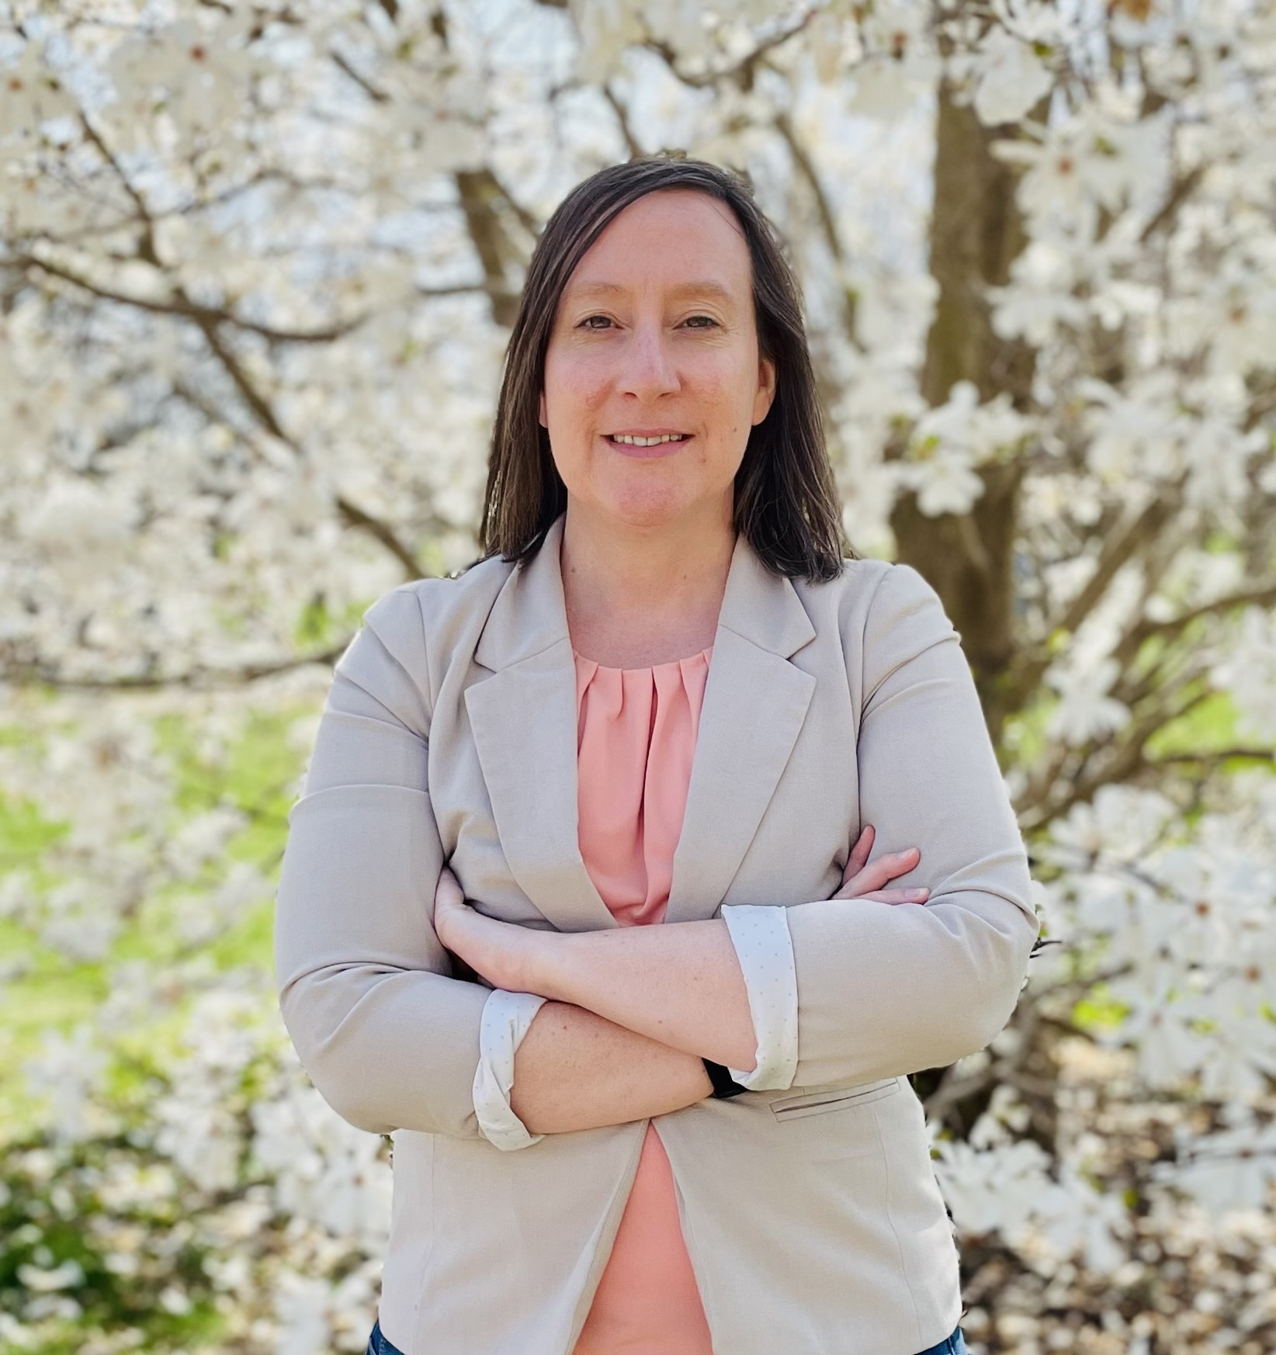
Who I am
Whitney Zahnd, PhD
Assistant Professor, University of Iowa College of Public Health
Past-president of the Iowa Rural Health Association
Member of the Cancer Epidemiology and Population Sciences Program, Holden Comprehensive Cancer Center

Slide 3

These slides will be posted
Survey
We would appreciate your feedback on this presentation.
We will send & post a link to a brief survey after this presentation.
These slides will be posted to the Iowa Cancer Registry website:
www.iowacancerregistry.org/99
If you have questions after, please email us at ICR-99countiesproject@uiowa.edu
Media
If you are a representative of the media and would like more information on this presentation or to speak with someone from the Iowa Cancer Registry, contact ICR-Media@uiowa.edu.

Slide 4





99 Counties Project Team

Slide 5
“Statistics are people with the tears wiped away”
Dr. Irving Selikoff

Slide 6
Rate of New Cancers
Iowa has the #2 highest rate of
new cancers in the U.S.
Iowa’s rate is
14% higher than the U.S. rate
Iowa
United States
2020 data not included
Notes:
2020 is excluded

Slide 7
Rate of Cancer Deaths
Iowa has the #23 highest rate of cancer deaths in the U.S.
Iowa’s rate is
3% higher than
the U.S. rate
Notes:
2020 is excluded

Slide 8
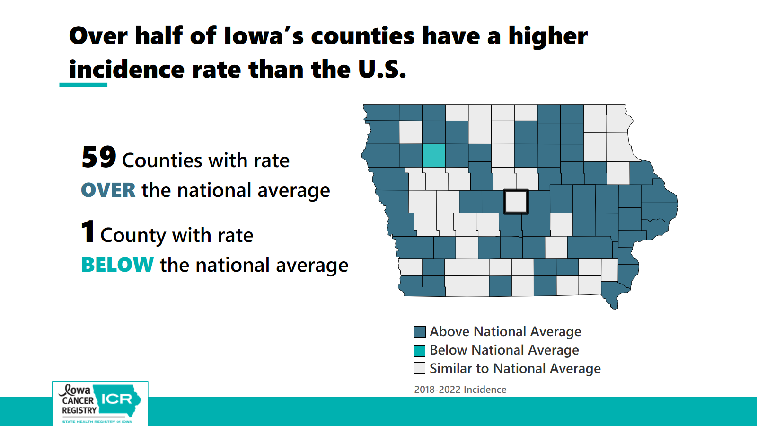

Slide 9


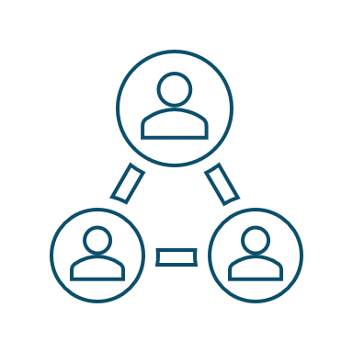

About the Project
Goal: to enhance community engagement & education around cancer prevention and control across all of Iowa’s 99 counties.
Present county-specific cancer data
Listen
Provide Resources
Recommend actions

Slide 10








There are Many Cancer Control Partners in Iowa
State Government
Unity Point, MercyOne, Great River, Avera, Mayo, Methodist, Gundersen, Sanford and numerous independent health systems, hospitals and clinics across Iowa
Provide cancer prevention, screening, treatment, and survivorship services
Bureau of Chronic, Congenital
and Inherited Conditions
Iowa’s only NCI Designated Cancer Center
Health Care, research,
education
Comprehensive Cancer
Control Program
Cancer prevention, screening, survivorship
Care for Yourself (Breast & Cervical Cancer Program)
Colorectal Cancer Screening Program
Governor
Implement state laws
Advance and pursue policies and programs
Data, support research & education
Advocate, collaborate, plan
Bureau of Environmental
Health Services
Track environmental health-related diseases
Assist local boards of health
UI Research Centers
Iowa
Legislature
Propose and vote on legislation
Appropriate money to state agencies and programs
Create and modify Iowa laws
Iowa Cancer
Action Network
Advocate for better policies
Local (County) Public Health
Services/Boards of Health
Address health priorities and health disparities
Promote healthy living
Protect against environmental hazards
Assure access to health services
Center for Health Effects of Environmental Contamination
ACS Iowa
Help with cancer treatment and recovery
Notes:
4 points of this slide
This is a busy slide, but it’s just to show that there are many cancer control partners in Iowa
State and local government plays an important role in policies and funding to address cancer in the state
There are many other cancer partners across the state, such as our only state NCI-designated cancer center, and we will highlight many of these later in the presentation.
The Iowa Cancer Registry is one piece of the puzzle. ICR collects the data.

Slide 11



Iowa Cancer Registry Goals
Assemble & report data on new cancers, cancer deaths, & survival
Respond to data requests from organizations & individuals
Support studies for cancer prevention, research & education

Slide 12
Federal Funding for Cancer Control in Iowa
The Iowa Cancer Registry is funded in part with Federal funds from the National Cancer Institute (National Institutes of Health), Department of Health and Human Services, under Contract No. HHSN261201800012I
The Cancer in Iowa: 99 Counties Project is specifically funded by Federal funds from the National Cancer Institute through grant award: 5R01CA254628-04S2, and through National Cancer Institute funds provided to the University of Iowa Holden Comprehensive Cancer Center (P30CA086862)
The Iowa Cancer Consortium acknowledges the Centers for Disease Control and Prevention (CDC) for its funding support under cooperative agreement NU58DP007103 awarded to the Iowa Department of Health and Human Services (Iowa HHS).
The contents of this presentation are solely the responsibility of the authors and do not necessarily represent the official views of CDC or the National Institutes of Health/National Cancer Institute.

Slide 13
Background on Cancer

Slide 14
Cancer is Complicated
Lifestyle
Environment
Genetic
Other
There is no one cause of cancer; it is a combination of different genetic, lifestyle, and environmental risk factors that change the function of cells

Slide 15
Cancer is Complicated
Lifestyle
Environment
Genetic
Other
Risk factors are things that increase your chances of getting cancer

Slide 16
Lifestyle
Environment
Genetic
Other
Notes:
ANIMATION SLIDE to help with flow

Slide 17
Tobacco
Alcohol
Unhealthy diet
Not being physically active
Sunburns
Lifestyle
Environment
Genetic
Other

Slide 18
Lifestyle
Environment
Genetic
Other
Family history of cancer
Random mutations

Slide 19
Lifestyle
Environment
Genetic
Other
Exposure to chemicals
Radiation

Slide 20
Lifestyle
Environment
Genetic
Other
Aging
Viruses (HPV, Hepatitis B)
Medical conditions like chronic inflammation

Slide 21
Cancer & the Environment
Many Iowans understandably have questions about potential links between environmental exposures and cancer
This is an important area of continued research, and Iowans are right to ask questions and be cautious
ICR, along with other population-based cancer registries, do not collect data on environmental risk factors, but we do share our data with researchers to support studies of cancer & environmental risk factors

Slide 22
Risk factors & cancer development
There can be many years between exposure to risk factors & cancer development, which makes it difficult to prove connections.
  For example, lung cancer may not occur until 30 years after a person starts smoking
Risk factors work together to increase risk
Today we will focus on things you can do to reduce your cancer risk. These things can be addressed at the state, community, and individual levels.

Slide 23
Key Terms

Slide 24
Incidence & Mortality
Incidence
  Number of new cases of cancer occurring during a specified time period in a population
Mortality
  Number of deaths from cancer that occur during a specified time period in a population

Slide 25
Rates & Counts
Counts
  The number of new cases diagnosed or deaths from cancer
Age-Adjusted Rates
  Addresses the question: If the size and age of the populations were the same, would there be a difference in rates?
  Adjusts the counts to give a # per 100,000 people

Slide 26
Stage definition used today
Early Stage includes
  Localized: cancer is limited to the place where it started, with no sign that it has spread
Late Stage includes
  Regional: cancer has spread to nearby lymph nodes, tissues, or organs
  Distant: cancer has spread to distant parts of the body
https://www.cancer.gov/about-cancer/diagnosis-staging/staging

Slide 27
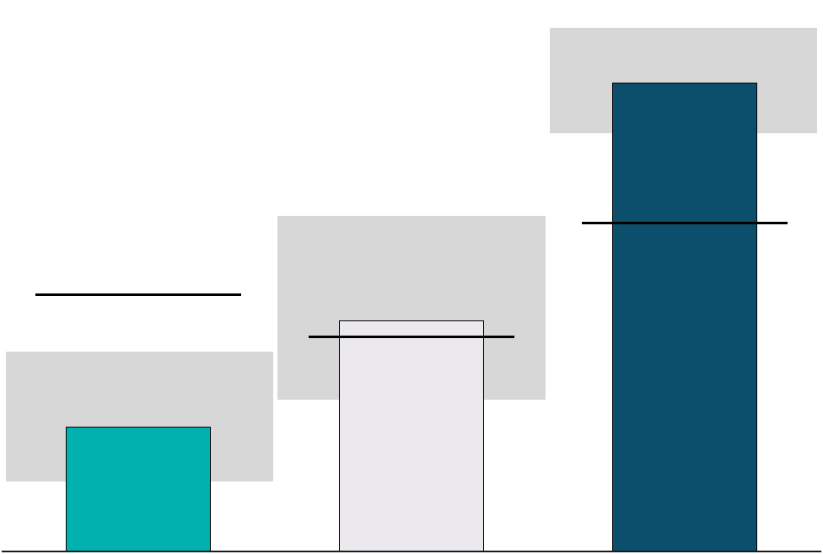
How to read the graphs
Grey boxes on bar graphs are 95% Confidence Intervals.
These are used to determine if rates are statistically different from each other
Unless otherwise stated, bars are your county data
Black lines on bar graphs are United States data
Below National Rates
About the same as National Rates
Above National Rates

Slide 28
Cancer in
Story County

Slide 29
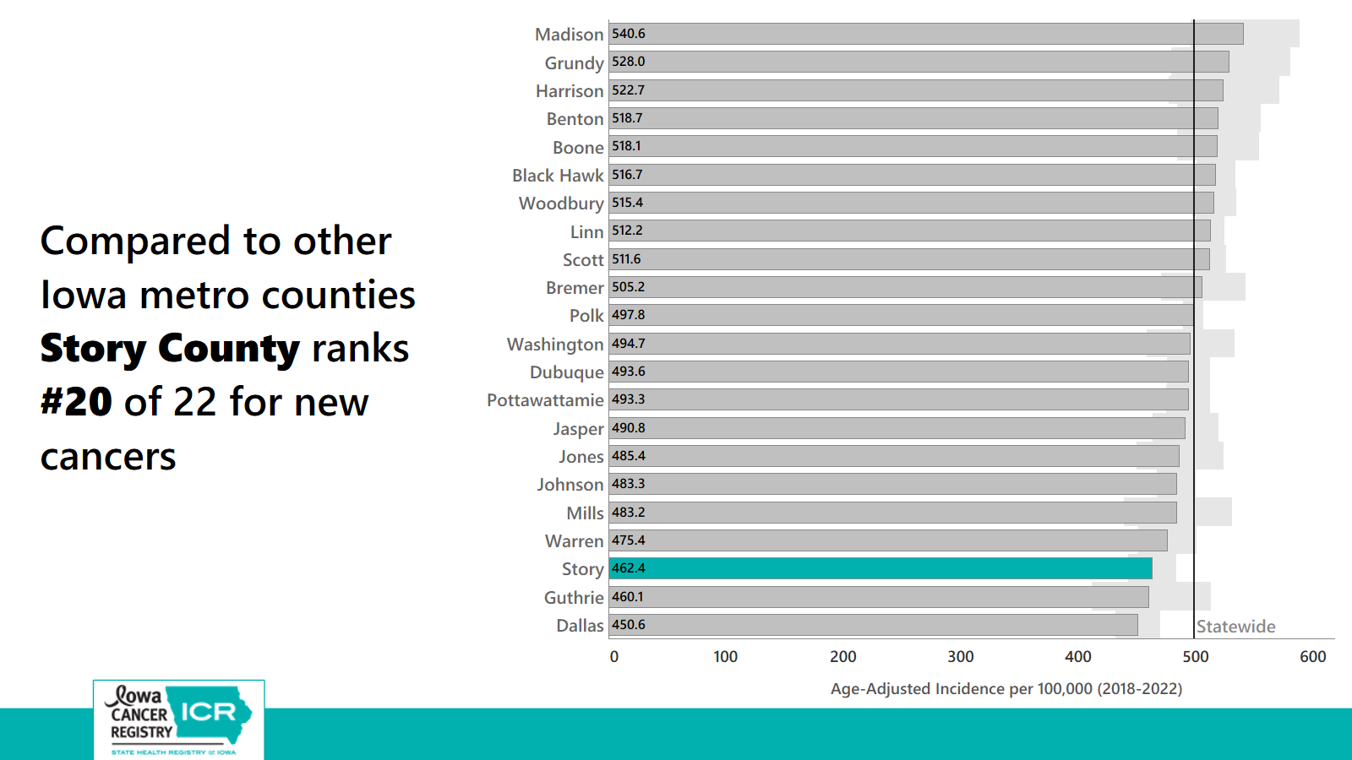

Slide 30
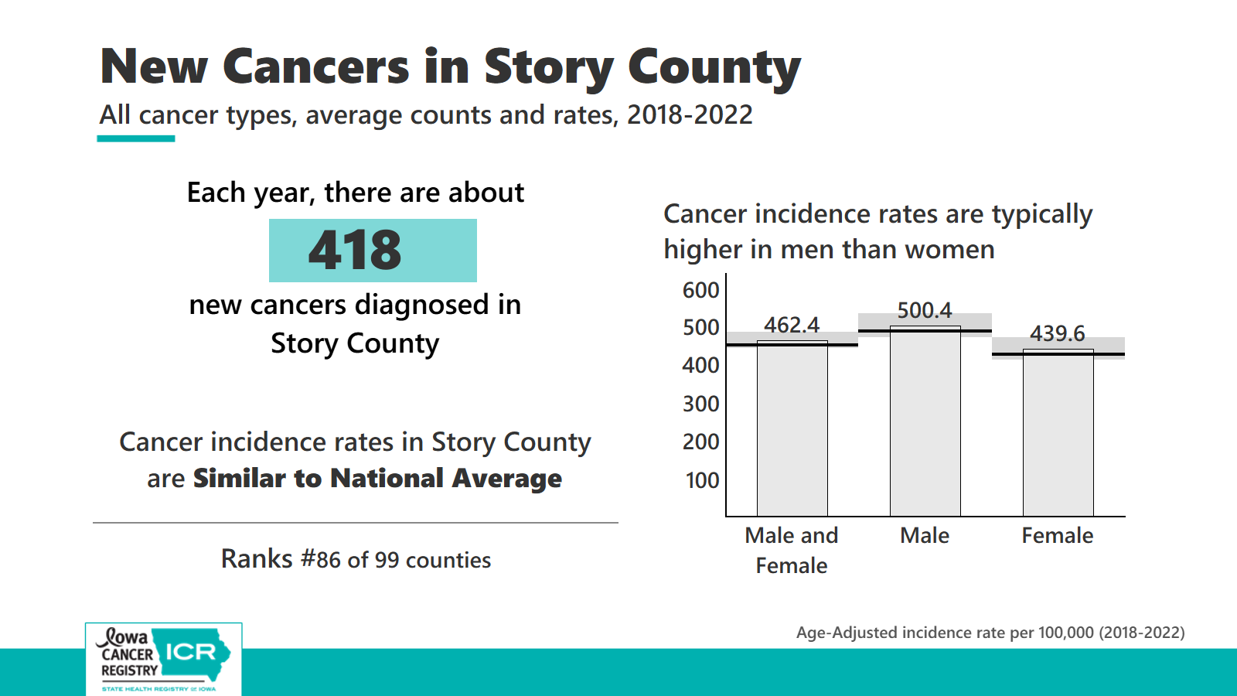

Slide 31
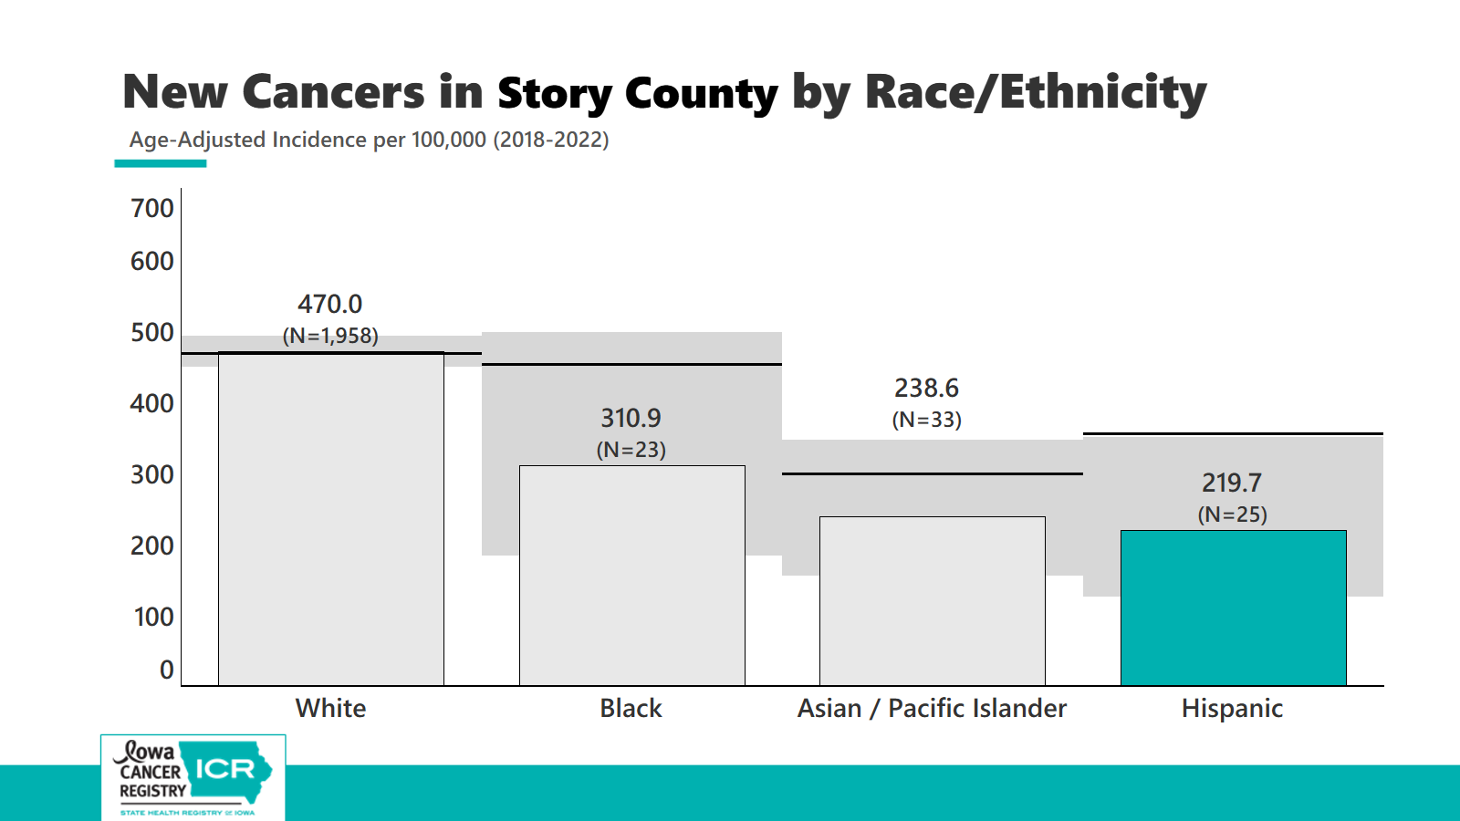

Slide 32
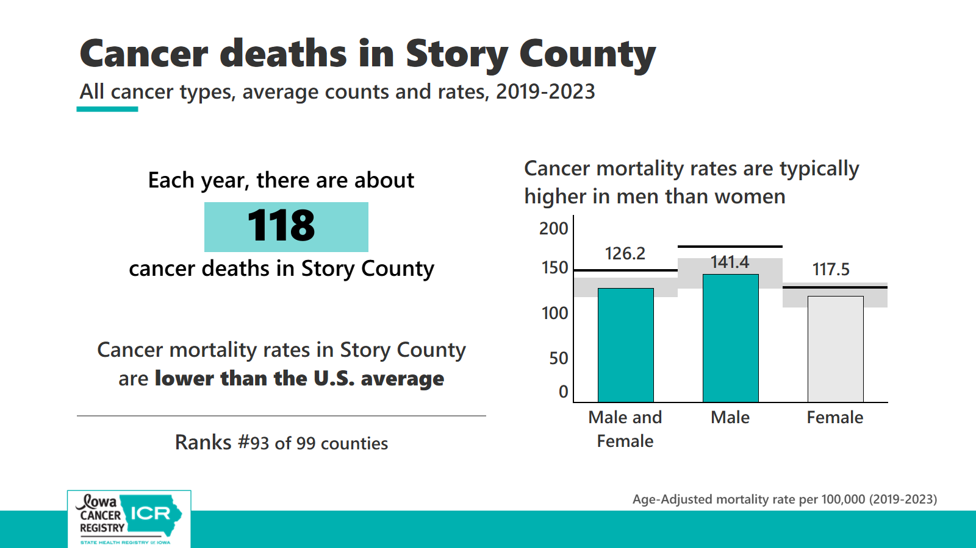

Slide 33
Pediatric, Adolescent, and Young Adult
New Cancers in Iowa
Pediatric cancer incidence rates in Iowa are not different than the U.S. rate
Adolescent cancer incidence rates in Iowa are not different than the U.S. rate
Young Adult cancer incidence rates in Iowa are higher than the U.S. rate
Age-Adjusted incidence rate per 100,000 (2018-2022)
Notes:
Before we talk about your county’s top cancers, we wanted to briefly touch on pediatric, adolescent, and young adult cancer rates. This is a very important topic to many Iowans.
Now due to small numbers we are unable to show rates by county, but we can show incidence rate for the state.
Of course, any number of cancer in these age groups is too high, but in looking at the rate for Iowa we see
For pediatric cancers, so individuals under 15 years of age, it is statistically similar to what we see for the nation.
For Adolescent cancers, those age 15-19 years old, incidence rate in Iowa is again statistically similar to the national rate.
Now looking at young adult cancers, so those between ages 20-39 years old at the time of their diagnosis, we do see that Iowa has a significantly higher incidence rate compared to the nation.

Slide 34
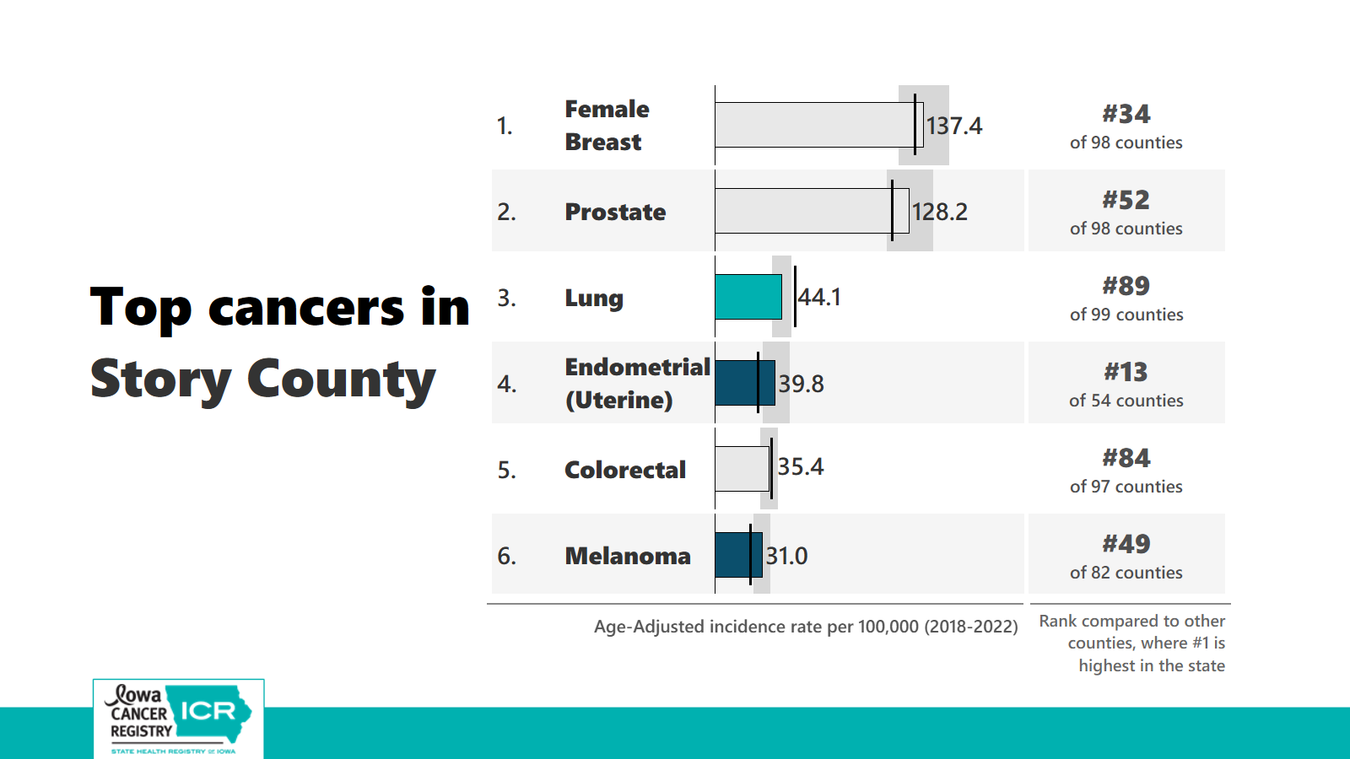

Slide 35
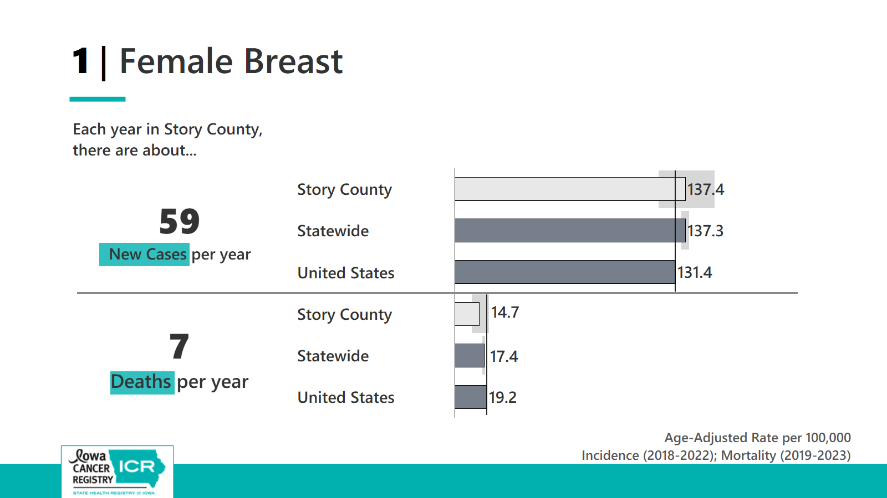

Slide 36
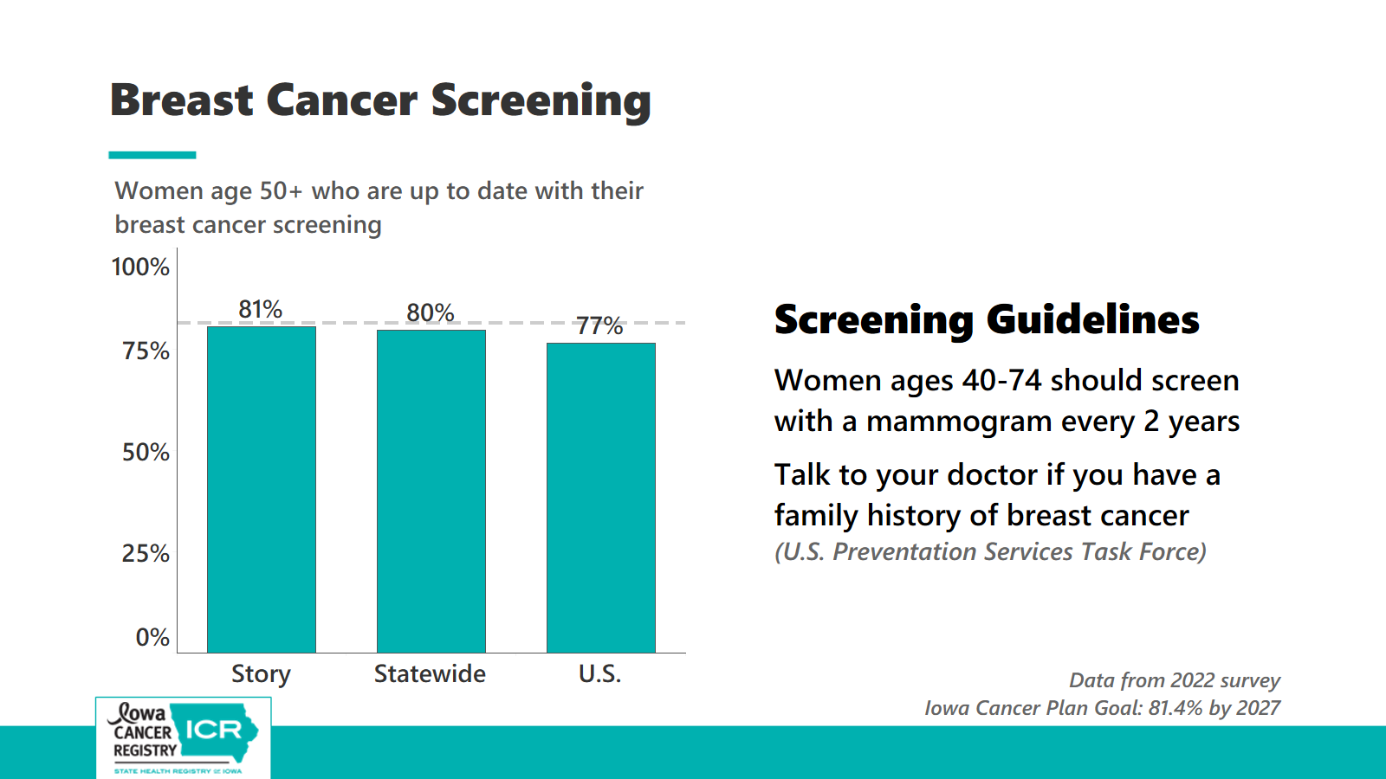

Slide 37
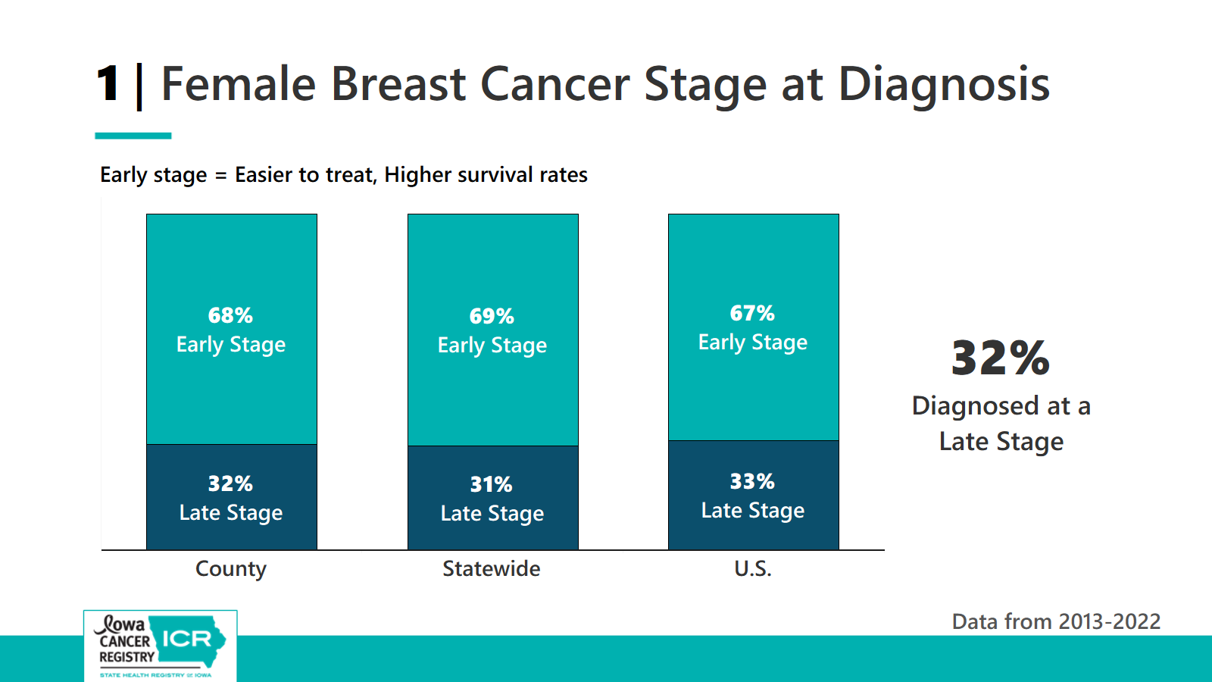

Slide 38

The Care for Yourself – Breast and Cervical Cancer Program (CFY-BCC)
We provide free breast and cervical cancer screenings across Iowa.
CFY-BCC is also called the Iowa Breast and Cervical Cancer Early Detection Program.
CFY-BCC serves Iowans between 21 and 64 years of age.
Are at or earn less than 250% of the Federal Poverty Level.
Call (866) 339-7909 to speak to a confidential coordinator immediately.
CFY-BCC coordinators are available to help you Monday-Friday, 8:00 a.m. to 4:00 p.m.
https://hhs.iowa.gov/public-health/cancer/cfy
Notes:
For those who are eligible, CFY-BCC covers annual mammograms.
The CFY Program receives funding from the Centers for Disease Control and Prevention (CDC)’s National Breast and Cervical Cancer Early Detection Program (NBCCEDP) grant. The CFY Program also receives funding from the state and additional funding from breast cancer license plates.
Individuals are eligible for the CFY program if they:
•Earn less than 250% of the Federal Poverty Level.
•Are uninsured, underinsured, or have insurance with barriers to receiving care.
•Are ages 40-64 for breast cancer services.
•Are ages 21-64 for cervical cancer services.
•Are symptomatic or high-risk under the age 40 years and those over 64 who do not have Medicare Part B.
•Serves individuals with breast/chest tissue and/or a cervix.
The CFY Program provides the following clinical services:
•Clinical breast/chest exams
•Mammograms breast MRIs
•Pap tests
•HPV tests
•Diagnostic testing for abnormal screening results and referrals to treatment
The CFY Program also provides the following services:
•Patient Navigation
•Help understanding provider recommendations
•Appointment reminders

Slide 39
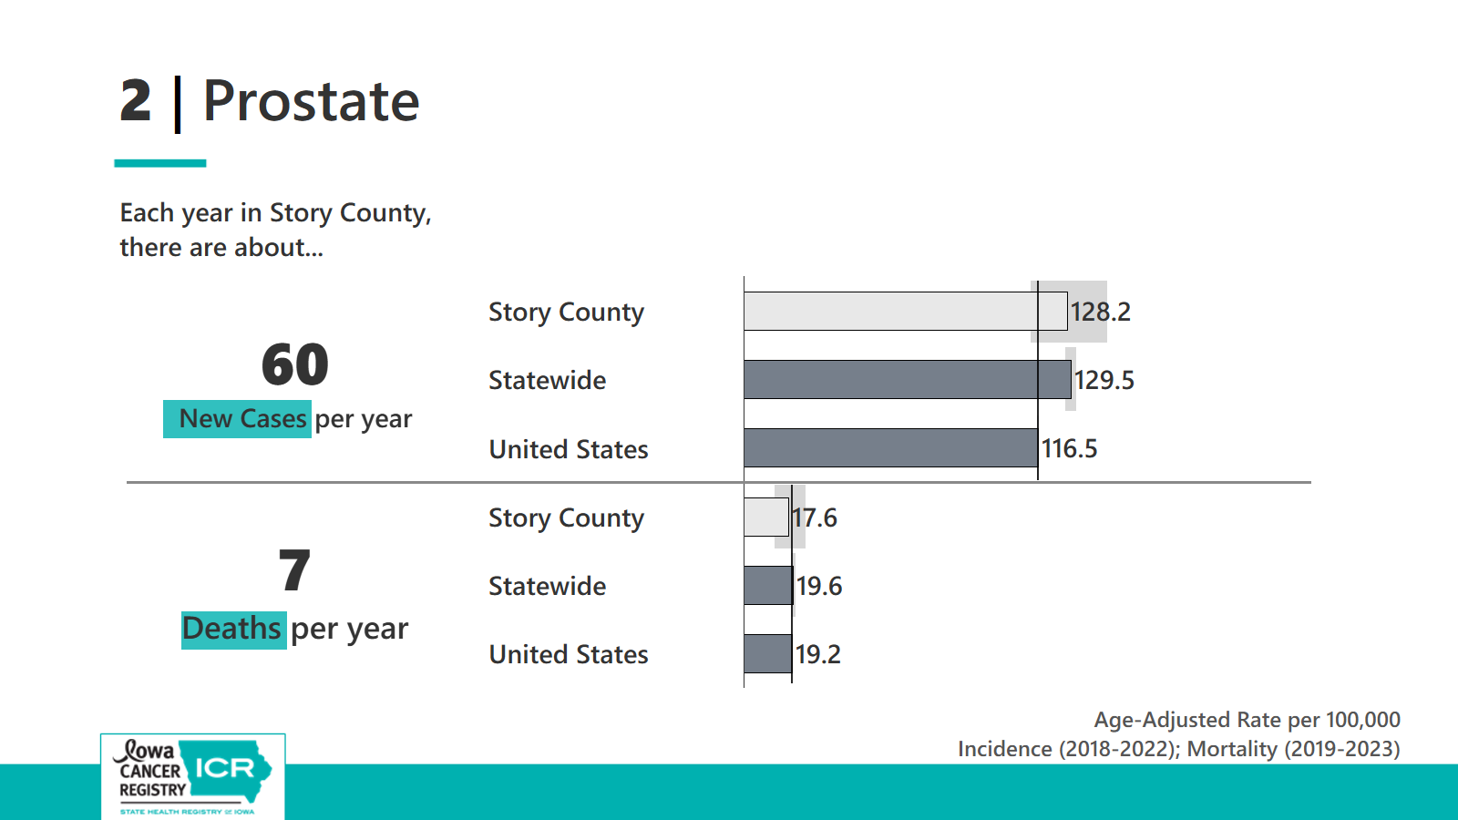

Slide 40
Prostate Cancer Screening Guidelines
Screening test is a Prostate-specific antigen (PSA) blood test
U.S. Preventative Services Task Force
American Cancer Society
If you have a prostate and are 55-69 years old, discuss with your doctor if a PSA test is right for you
https://www.uspreventiveservicestaskforce.org/uspstf/recommendation/prostate-cancer-screening
The American Cancer Society recommends that men have a chance to make an informed decision with their health care provider about whether to be screened for prostate cancer.
The discussion about screening should take place at:
Age 45 for men at high risk of developing prostate cancer. This includes African American men and men who have a first-degree relative (father or brother) diagnosed with prostate cancer at an early age (younger than age 65).
Age 50 for men who are at average risk of prostate cancer and are expected to live at least 10 more years
Age 40 for men at even higher risk (those with more than one first-degree relative who had prostate cancer at an early age)

Slide 41
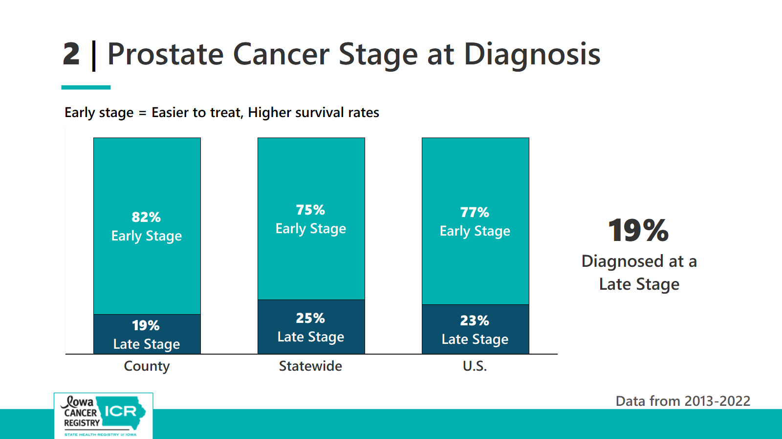

Slide 42
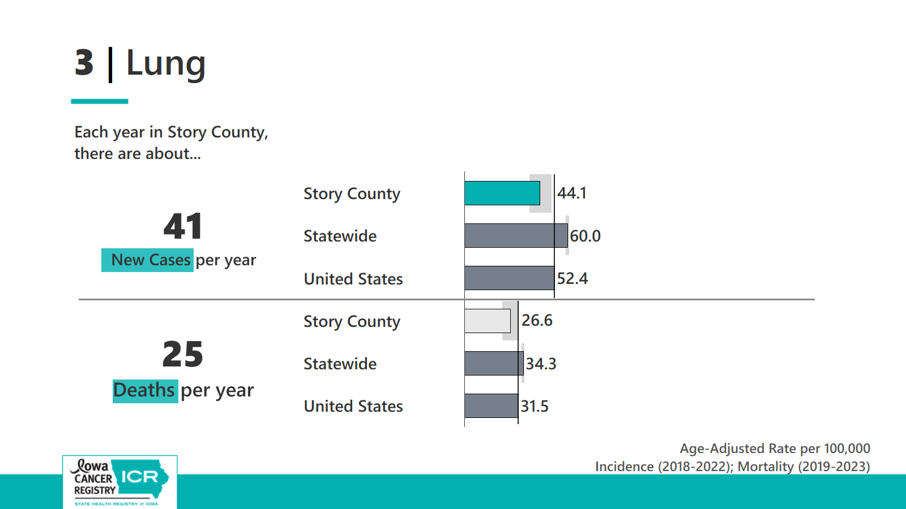

Slide 43
Lung Cancer Screening
Screening Guidelines
Low-dose CT scan
If you have smoked in the last 15 years and are between the ages 50-80 years talk to your doctor about being screened for lung cancer
18.4%
(U.S. Preventative Services Task Force)
Notes:
Screening for lung cancer with annual low-dose CT scans among those at high risk can reduce the lung cancer death rate by up to 20% by detecting the disease at early stages when it is more likely to be curable.
Screening stat: American Lung Association State of Lung Cancer Report 2025

Slide 44
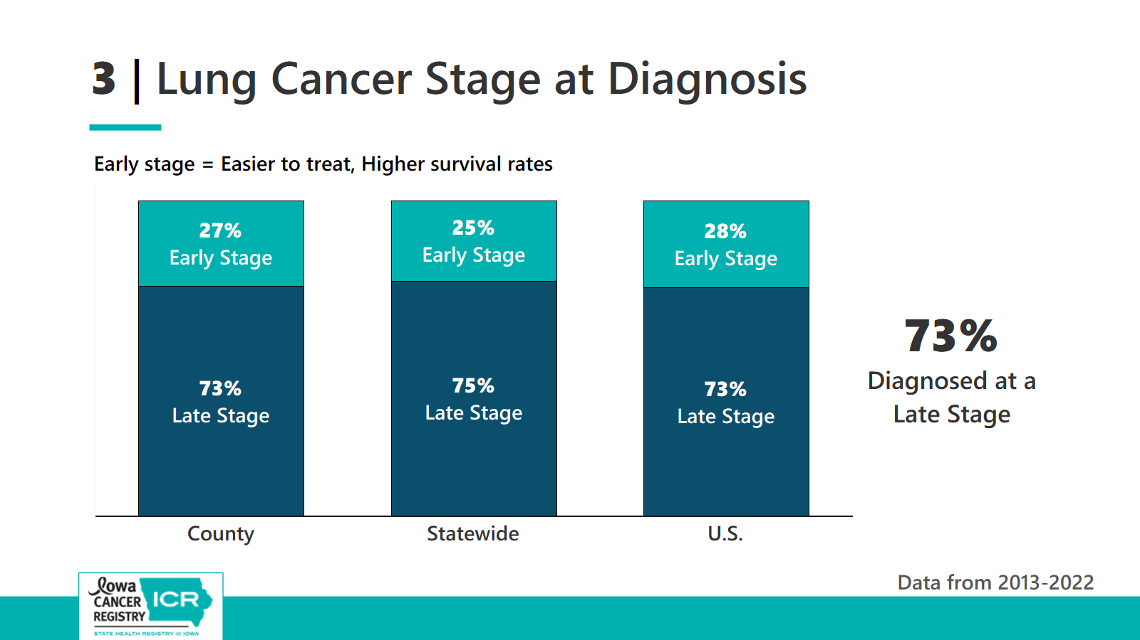

Slide 45


Lung Cancer Risk Factors
Smoking is #1 cause of lung cancer
Learn more about Radon testing
and mitigation:
Iowa Health & Human Services
hhs.iowa.gov/radiological-health/radon
Iowa Cancer Consortium
canceriowa.org/radon/
Radon is #2 leading cause of lung cancer
Test your home for radon and mitigate
People who smoke that are exposed to radon are at a 10 to 20 times higher risk of developing lung cancer than non-smokers
Notes:
Smoking is the leading cause of lung cancer – so quitting smoking is one of the best things you can do to decrease your risk of lung cancer
Radon
2nd leading cause of lung cancer
#1 cause of lung cancer among non-smokers – so testing your home for radon and if it is detected installing a radon mitigation system to reduce your risk
Secondhand smoke is the 3rd leading cause of lung cancer
https://www.atsdr.cdc.gov/environmental-medicine/hcp/clinicianbriefradon/index.html#cdc_generic_section_10-other-sources-of-information-on-radon

Slide 46
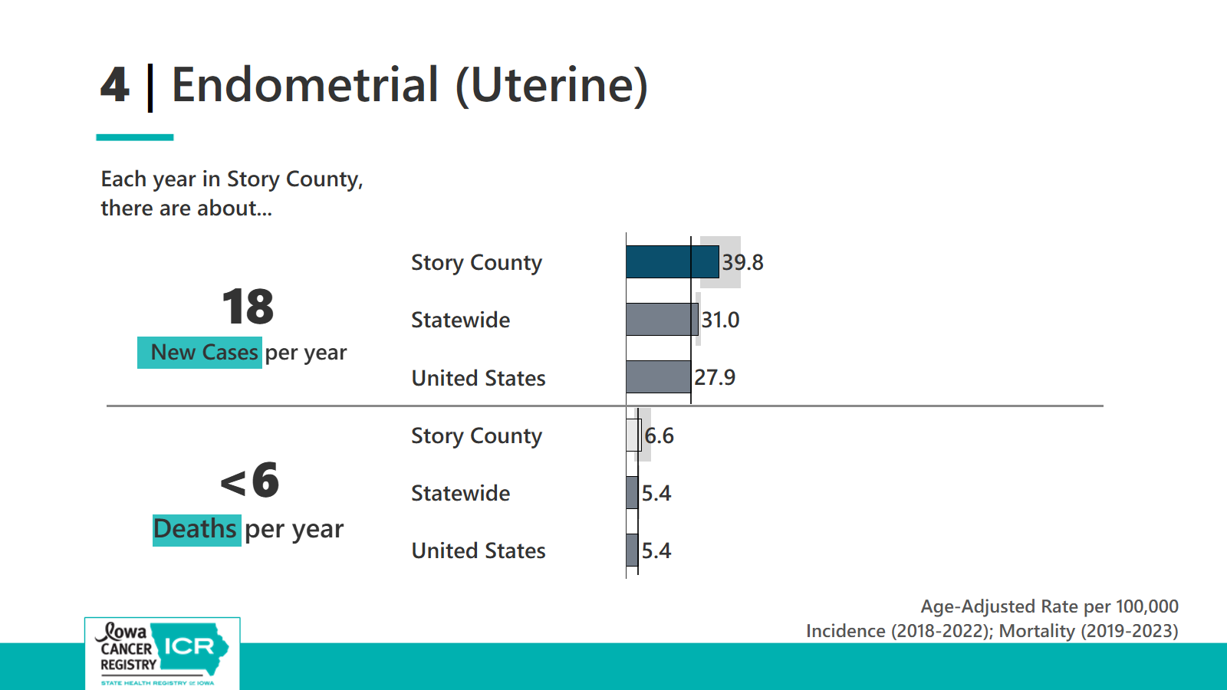

Slide 47
Endometrial (Uterine Cancer)
Talk to your doctor if you experience…
Vaginal bleeding or discharge not related to menstruation (periods)
Vaginal bleeding after menopause
Difficult or painful urination
Pain during sexual intercourse
Pain in the pelvic area
Notes:
There is no standard screening test for endometrial cancer
https://www.cancer.gov/types/uterine/patient/endometrial-treatment-pdq

Slide 48
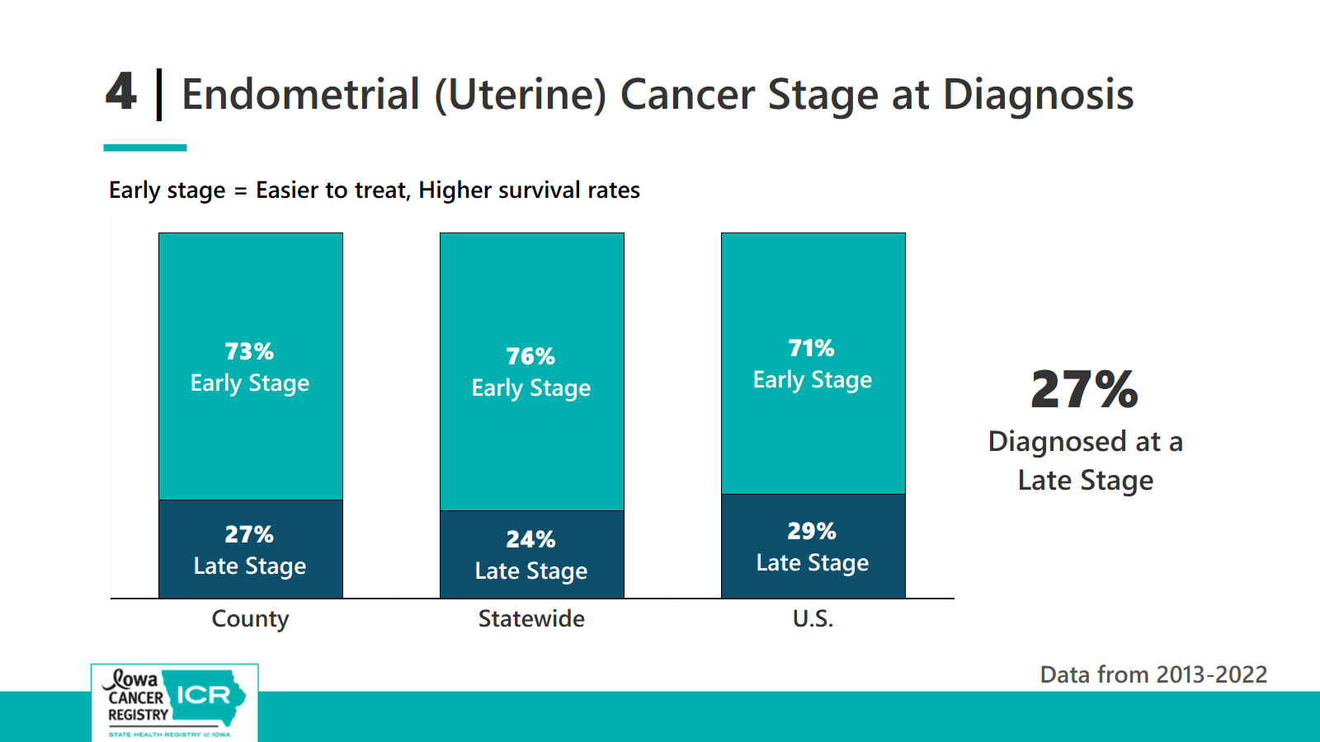

Slide 49
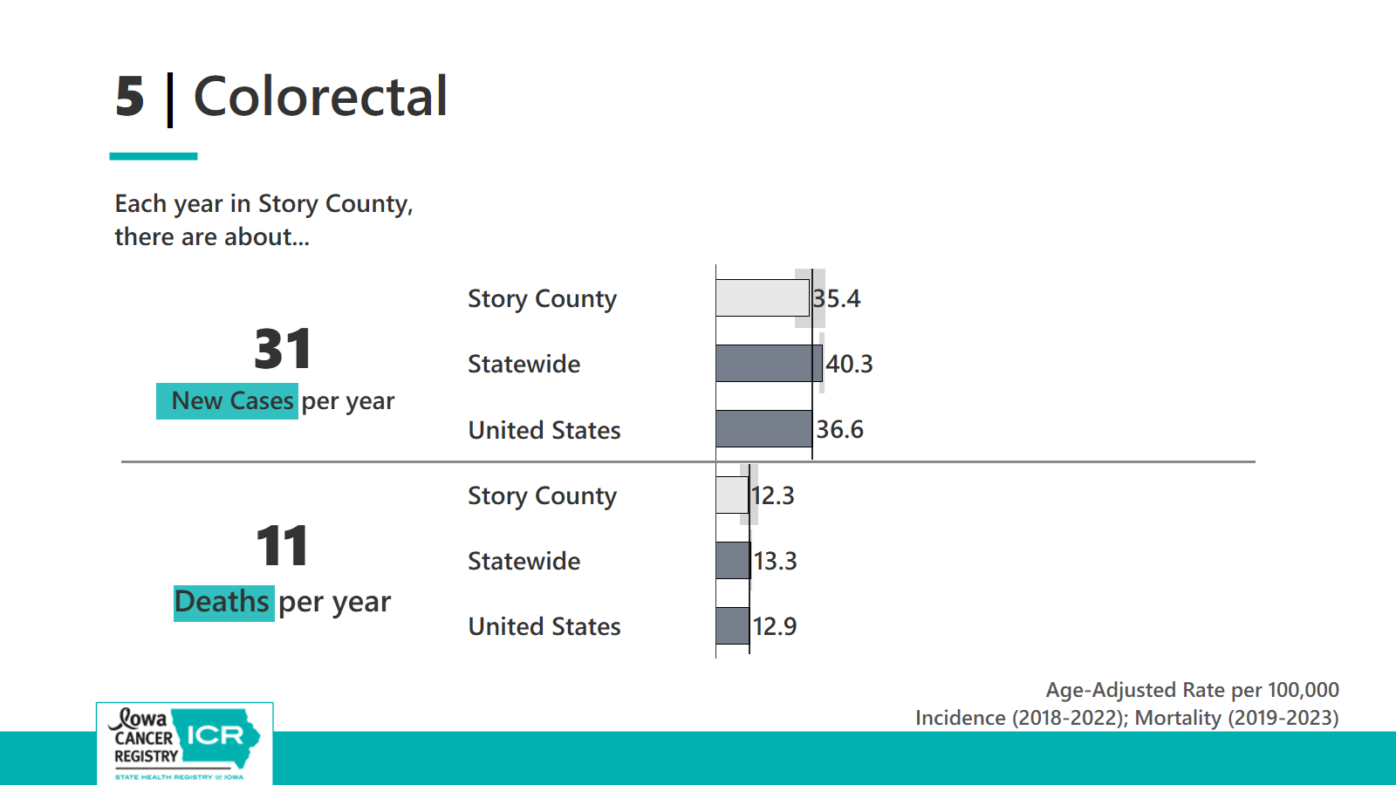

Slide 50
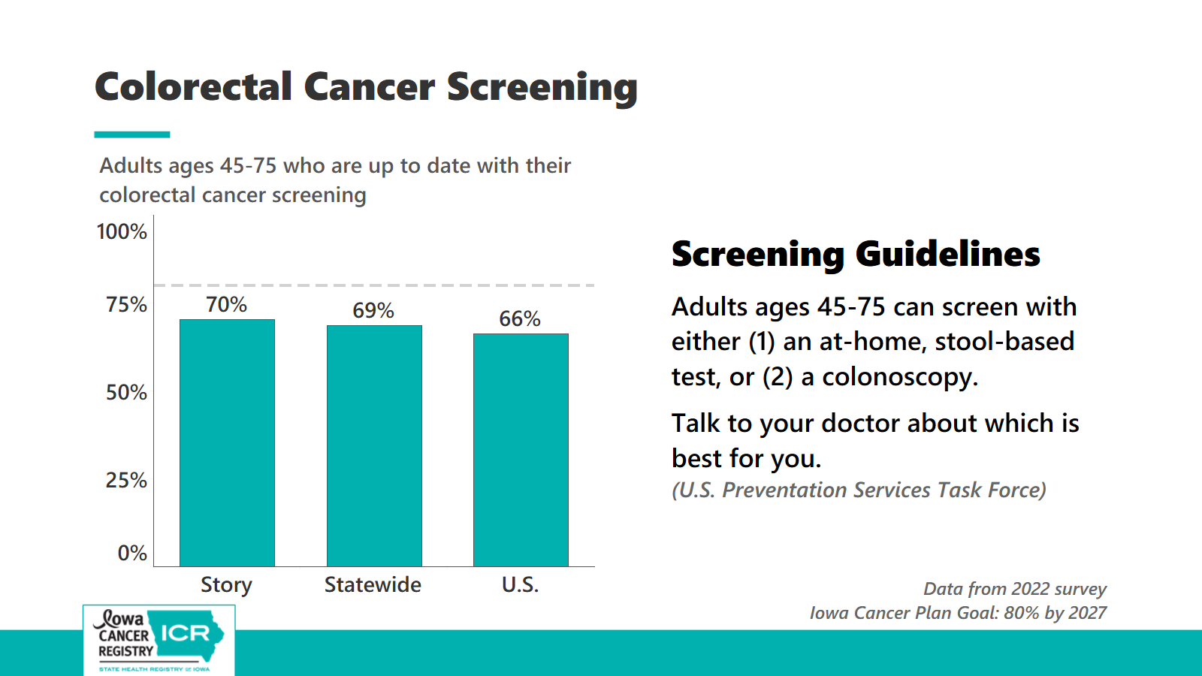

Slide 51
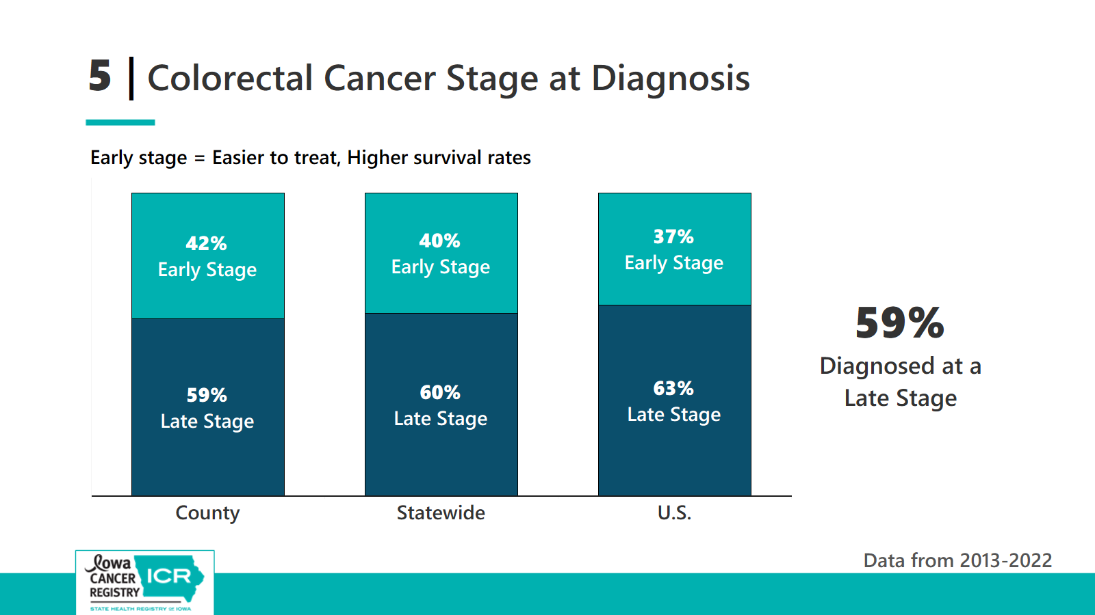

Slide 52

Iowa Get Screened (IGS): Colorectal Cancer Program
We partner with Iowa’s Federally Qualified Health Centers (FQHCs) and local public health agencies to increase colorectal cancer screening.
Through a collaboration with the Iowa Primary Care Association (Iowa PCA) and FQHCs, the program serves low-income Iowans, ages 45-75, to:
Increase the number of cancers prevented
Increase the diagnosis of early-stage colorectal cancer
Reduce colorectal cancer incidence and mortality in the state
https://hhs.iowa.gov/public-health/cancer/colorectal-cancer-screening-program
Notes:
Colorectal Cancer (CRC) Program The Colorectal Cancer Program at Iowa HHS receives funding from the Centers for Disease Control and Prevention (CDC)’s Colorectal Cancer Control Program (CRCCP) grant and funding from the state to administer the Iowa Get Screened (IGS) Program.
Participating FQHCs (clinics) include: 1) All Care Health Center, 2) Community Health Care, Inc., 3) Community Health Centers of Fort Dodge, 4) Infinity Health,
5) Community Health Centers of Southeastern Iowa, 6) Crescent Community Health Center, 7) Eastern Iowa Health Center, 8) Primary Health Care, Inc., 9) Promise Community Health Center and 10) River Hills Community Health Center.
The state-funded Iowa Get Screened Program provides limited colorectal cancer screenings to eligible Iowans at the Black Hawk County Health Department (in Waterloo) and the Polk County Health Department (in Des Moines). This program serves Iowans ages 45-75, who are at or below 300% Federal Poverty Level, and are uninsured or underinsured. The participants can live in any Iowa county to participate. These services are provided through the following partnerships: MercyOne Waterloo, Broadlawns Medical Center and Mercy Clinical Labs.

Slide 53
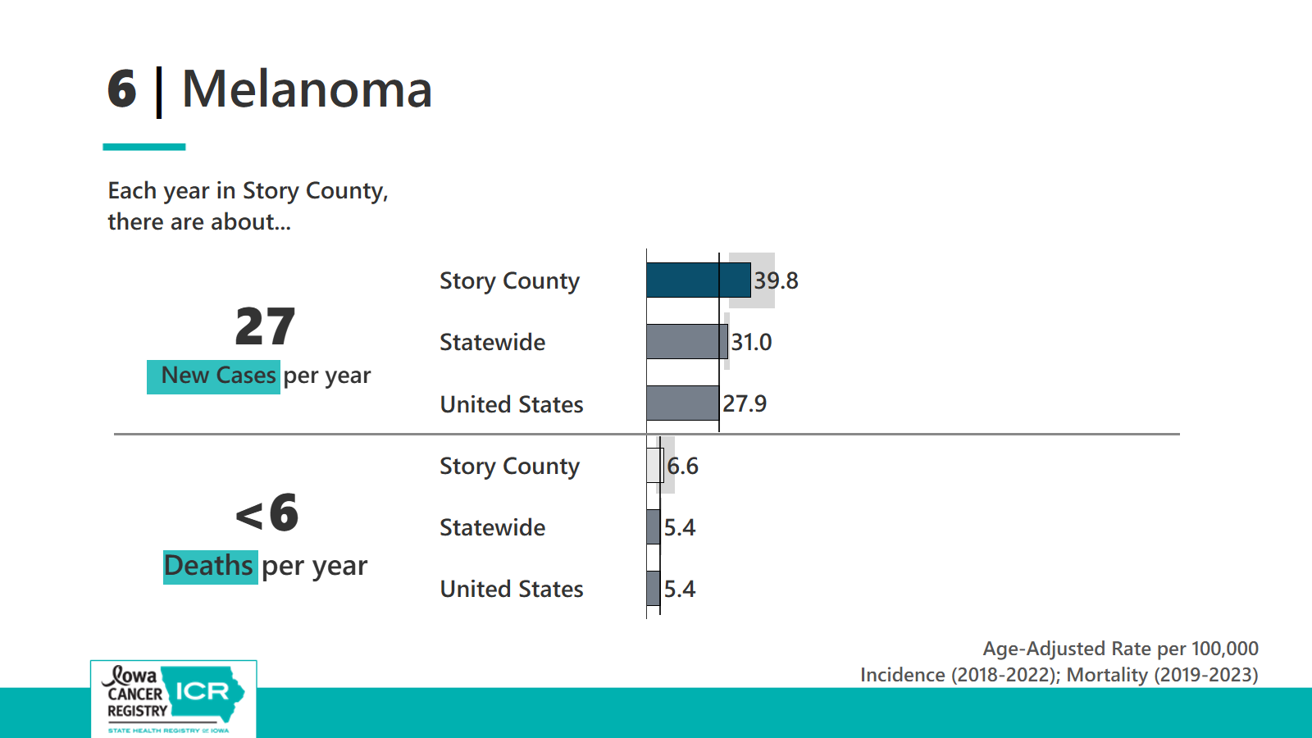

Slide 54
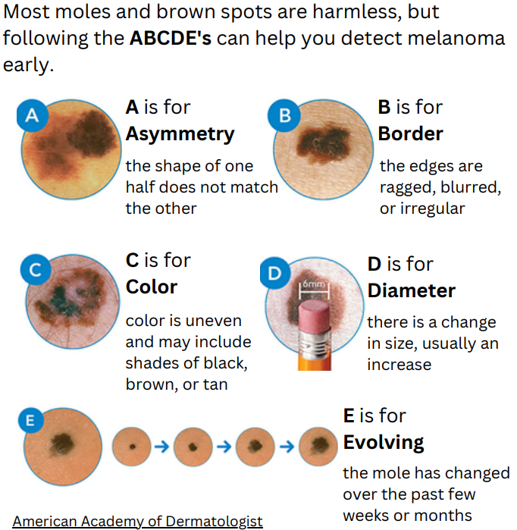
Melanoma Self-Exams
Perform regular self-examinations using a mirror. If you find new spots or changes in existing spots talk to your doctor.
Check out the Iowa Cancer Registry Melanoma Spotlight
Notes:
Melanoma doesn’t have screening guidelines like breast cancer.
You can also see if your insurance covers yearly skin cancer checks.
https://shri.public-health.uiowa.edu/wp-content/uploads/2023/06/Skin-Melanoma_FINAL.pdf

Slide 55
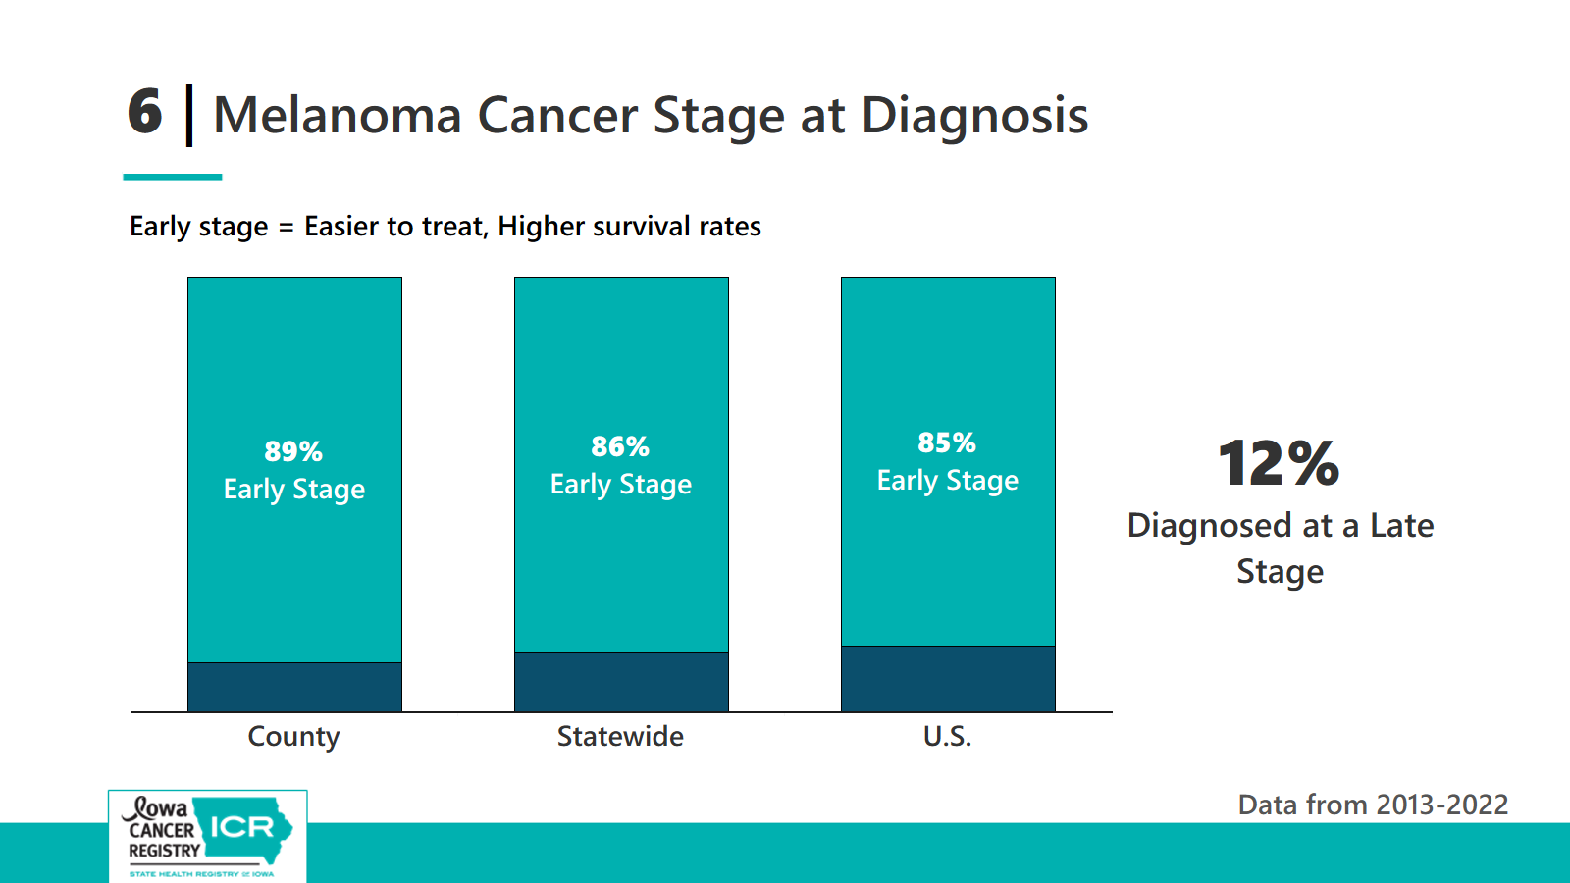

Slide 56






What can you do to prevent melanoma?
~92% of melanoma cases are attributable to UV exposure
Wear broad spectrum sunscreen with at least SPF 30
Do not use indoor tanning beds
Just one indoor tanning session increases a person’s chances of developing melanoma by 20%.
Using a tanning bed before age 35 increase a person’s risk for melanoma by 75%.
Tanning bed users are more likely to have multiple melanomas on areas of the body that typically received less sunlight (torso). Tanning bed use may lead to more cell mutations, increasing risk of melanomas.
Avoid being in the sun between 10am – 2pm
Wear long sleeves and hats and sit in the shade when outdoors
Notes:
Iowa is one of the few states with no restrictions on tanning be
https://azskincancerinstitute.org/sci/skin-cancer-prevention/tanning-bed-dangerd use for minors.
https://www.iarc.who.int/media-centre-iarc-news-32/
https://publications.iarc.who.int/Book-And-Report-Series/Iarc-Working-Group-Reports/Exposure-To-Artificial-UV-Radiation-And-Skin-Cancer-2006
Page 50: Our systematic review of published studies, conducted mainly in North America and Europe, of the association of indoor tanning facility use with melanoma revealed an association of early age at first use (less than approximately 30 years) with melanoma risk. These studies consistently indicated a moderate strength of association, with a summary relative risk of 1.75 (1.35–2.26).
https://www.the-scientist.com/tanning-beds-and-natural-sunlight-affect-melanocytes-differently-73848?utm_campaign=5750943-TS_News%20Alerts_2025&utm_medium=email&_hsenc=p2ANqtz-_I77vigeyjI8G3k1ShptWrHd2dAhS-PyivUMyH8eAqvo8srEMrfh4AnrrG9n4Q2kuFI8V1wJYf5T_5DKrNiCZaHwzGPQ&_hsmi=398075549&utm_content=398075549&utm_source=hs_email
A recent study found that between tanning bed users and nonusers, those who tanned were more likely to have multiple melanomas on areas of the body with low amounts of sun damage.¹ Molecular analysis revealed that their skin cells harbored more pathogenic mutations, which may elevate melanoma risk. These findings highlight how tanning beds can affect skin cells differently than those who are exposed to natural, outdoor lighting.
The team observed that the tanning cohort was more likely to have multiple melanomas. The distribution of melanomas also differed. The tanning bed users more often had melanomas on areas of the body that typically receive less sunlight, such as the torso, compared to individuals exposed to natural sunlight.

Slide 57










How can you reduce your risk for cancer?
~40% of cancers in the US are attributable to modifiable risk factors
(i.e., smoking, alcohol, diet, infections, etc.)
Do not smoke or use any form of tobacco
Make your home smoke-free
Enjoy a healthy diet
Avoid too much sun, use sun protection
Limit alcohol consumption
Be physically active
Vaccinate against Hepatitis B and HPV
Reduce indoor and outdoor air pollution (including radon)
Decrease excess body weight
Get the appropriate cancer screenings for you!
Notes:
We know on a population level these risk factors, like smoking, increase the rates of cancer for a population. The higher the smoking rate, the higher the cancer rate. Conversely on the right-hand part of slide, the higher the rates of healthy diets and physical activity, the lower the rates of cancer for a population. What we don’t know is what caused cancer for a particular individual. There are very healthy people who did everything right and still were diagnosed with cancer. And there’s people who conversely lived unhealthy lifestyles and were not diagnosed with cancer.
While we can’t eliminate our risk, there are things we can do to reduce our risk of cancer, which include….[read slide].

Slide 58
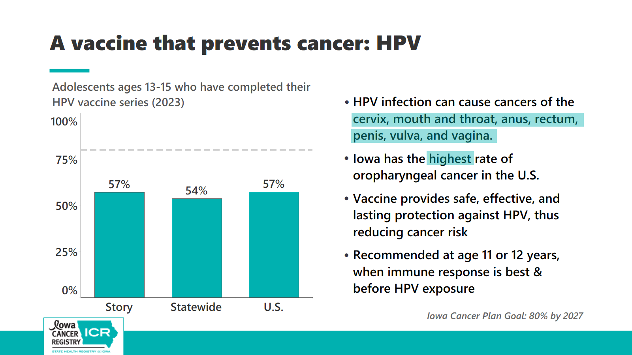

Slide 59
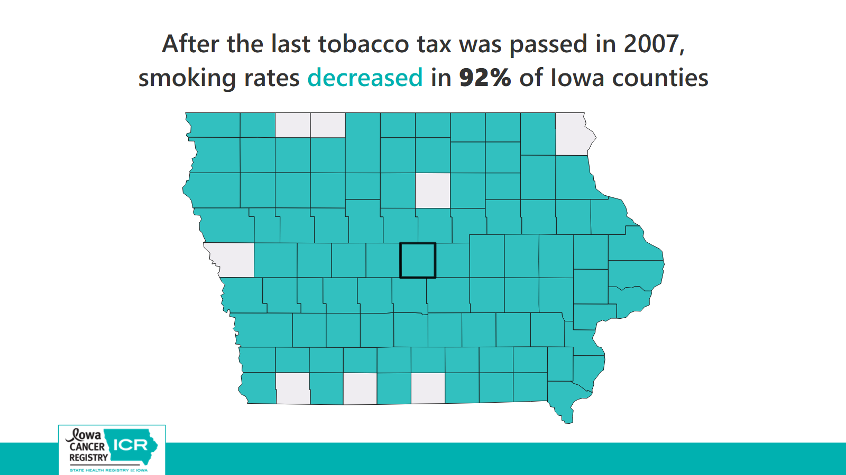

Slide 60
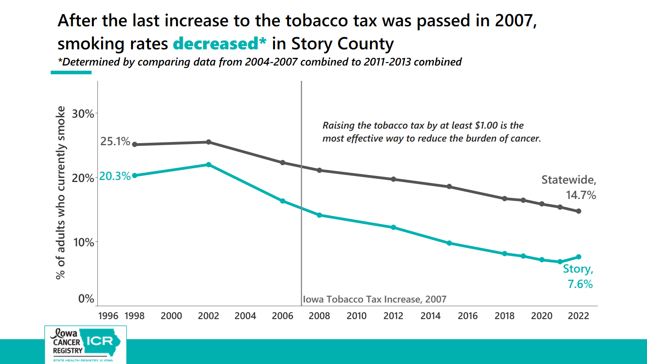

Slide 61
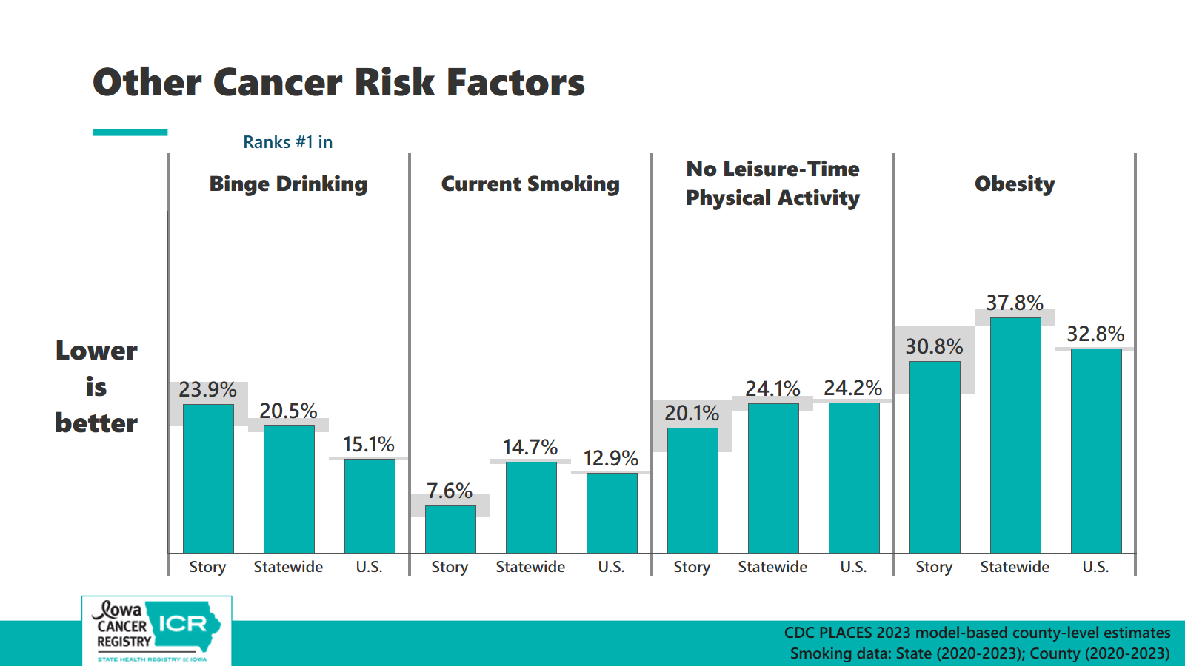

Slide 62

Want to know your cancer risk?
Take the American Cancer Society’s cancer risk assessment to learn more about what factors might affect your personal cancer risk and actions you can take to help lower your risk.
https://acscancerrisk360.cancer.org/

Slide 63
Resources to help understand and address cancer in Iowa communities

Slide 64


Iowa Comprehensive Cancer Control Program (CCCP)
Iowa Cancer Consortium
Work with partners to prevent cancer whenever possible and support cancer survivors across Iowa.
Mission: To advance cancer prevention and control through advocacy, equity, and collaboration.
Vision: An Iowa where cancer is not a burden.
  A non-profit cancer coalition that provides
  Connections and partnership
  Latest news and cancer updates via email
  Training and educational opportunities
  Grant opportunities and technical assistance
  Free cancer educational materials for distribution
  Virtually-hosted workgroups
  The Iowa Cancer Plan
The CCCP partners with many organizations, including the Iowa Cancer Consortium, Iowa’s cancer coalition.
CCCP is involved in the revision and implementation of the Iowa Cancer Plan.
Currently CCCP is focused on increasing HPV vaccination, increasing lung cancer screening, and supporting cancer survivors.
https://hhs.iowa.gov/public-health/cancer
https://canceriowa.org/iowa-cancer-plan/
www.canceriowa.org
Funded in part through a contract with the Iowa CCCP
Notes:
ICC is funded through the Iowa Comprehensive Cancer Program

Slide 65

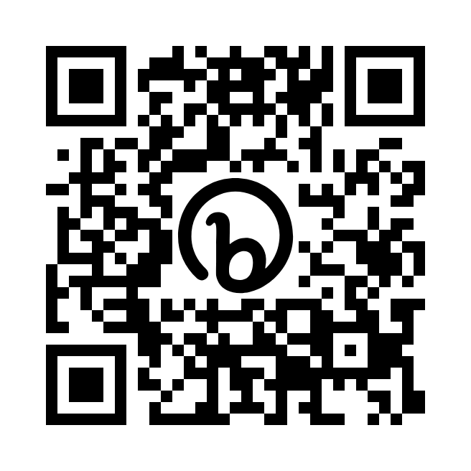
Blueprint for cancer control, the Iowa Cancer Plan
Chapters with sections that include priorities, strategies, and specific action steps which may be tailored to many settings to guide cancer control activities.
Health Equity: identify and eliminate cancer health disparities.
Prevention and Risk Reduction: whenever possible, prevent cancer from occurring.
Early Detection and Screening: promote the benefits of screening tests to ensure early diagnosis.
Diagnosis and Cancer-Directed Therapy: reduce barriers to care, promote evidence-based practices, and encourage participation in clinical trials and other forms of research.
Survivorship and End-of-Life Care: ensure resources to optimize quality-of-life for cancer survivors and their families.
https://canceriowa.org/iowa-cancer-plan/

Slide 66
"There is a lot we know about how to reduce our personal cancer risk. There is opportunity for the biggest impact when policies help us do that.
Effective policies
  make the healthy choice easier
  make the unhealthy choice harder
  provide protections from risk factors that are out of an individual’s control"
- Iowa Cancer Consortium

Slide 67
Policy Examples
State-level
Community & Organization-level
Increase the tobacco tax by at least $1.00
Raise taxes on alcohol and set minimum unit prices
Prohibit minors' use of tanning beds
Implementing tobacco- and nicotine-free policies
Zoning restrictions to prohibit tobacco shops from operating near schools or other tobacco retailers
Set and enforce limits on the number of places that sell alcohol and the distance between them
Reducing out-of-pocket costs for cessation treatments
Build communities that provide natural opportunity for physical activity (walkable/ bikeable/ accessible)
Ensure access to affordable fresh food
Providing sunscreen and UV-safety education in outdoor occupational, recreation/tourism, and childcare settings
Engaging community health workers, developing clinic-specific interventions, and supporting care navigation
Include cancer-relevant strategies in your hospital’s community health needs assessments or public health department’s needs assessment

Slide 68

More ways to get involved
American Cancer Society
Cancer Action Network
Contact your legislator
Engage American Cancer Society Cancer Action Network (ACSCAN) to promote cancer-relevant legislation
www.fightcancer.org
Find your legislator at
https://www.legis.iowa.gov/legislators/find

Slide 69
Story County Resources
Childhood Immunizations
Adults Immunizations
Childhood Immunization Clinics are offered
the 2nd and 4th Tuesday of every month 4pm-6pm
Appointments are required. Request an appointment online or call at 515-239-6730 or 800-529-4610.
Immunizations are available for people ages 19+ years
Mondays and Wednesdays from 8am - 12pm
Fridays from 10:30 am - 2:30 pm
Appointments are not required but are suggested. Request an appointment online or
call at 515-239-6730 or 800-529-4610.
https://www.mgmc.org/healthy-living/immunization-clinics/
Immunizations are available at the
Mary Greeley Medical Center East Building,
1114 Duff Avenue (across the street from the hospital)

Slide 70
Iowa Private Well Grants Program
Iowa Health & Human Services
Iowa's Private Well Grants Program (PWG) provides free water testing to all private well owners and users for the analytes listed.
The Iowa DNR recommends that all private well owners have their water tested at least annually.
Story County
For more information contact the Environmental Health Office at 515-382-7240 or healthweb@storycountyiowa.gov
https://www.storycountyiowa.gov/207/Private-Wells
Analytes
Bacteria/coliform (annually)
E.coli/fecal coliform (annually)
Nitrate (annually)
Arsenic (every 3 years)
Manganese (every 3 years)
PFAS (requires pre-approval from the DNR)
https://hhs.iowa.gov/public-health/environmental-health/private-well-grants
https://www.iowadnr.gov/environmental-protection/water-quality/private-well-program/well-testing

Slide 71
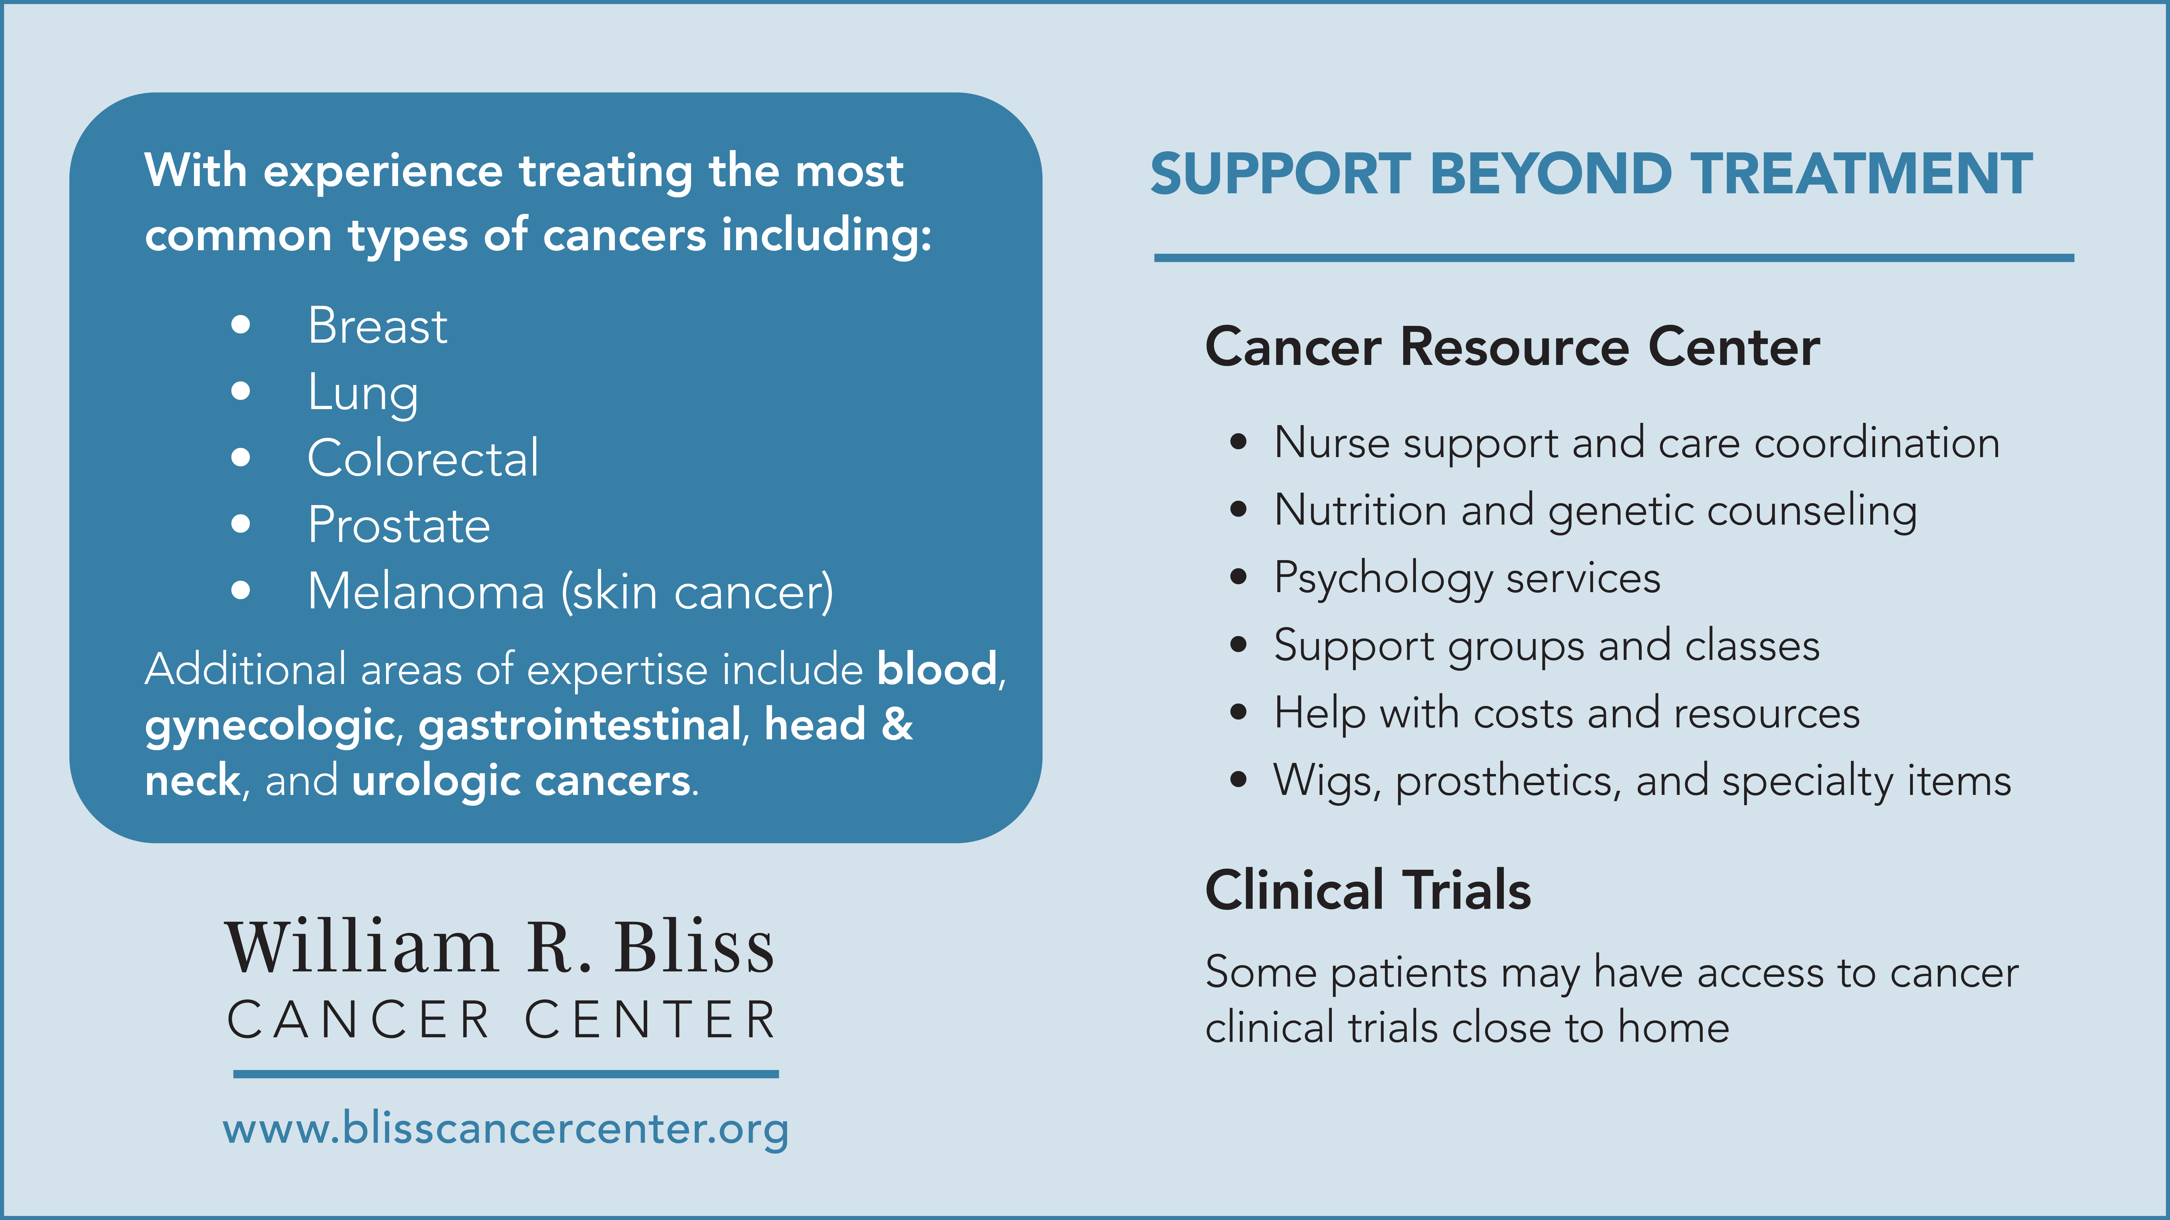

Slide 72
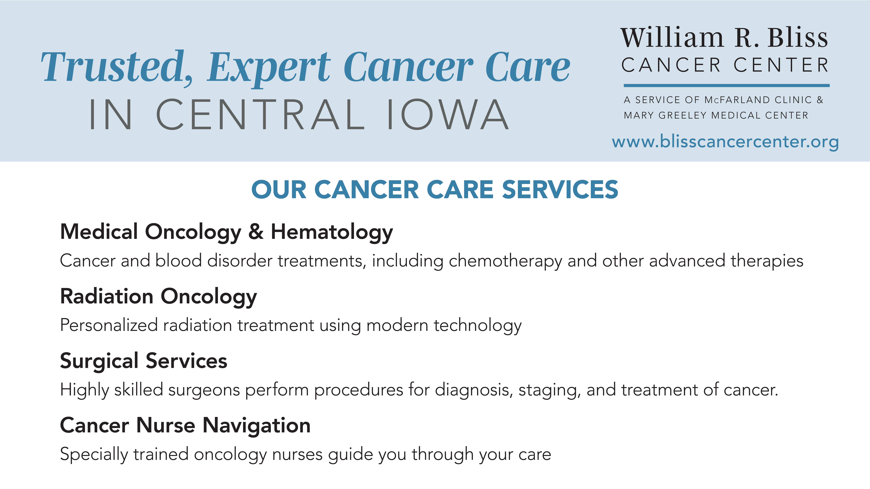

Slide 73
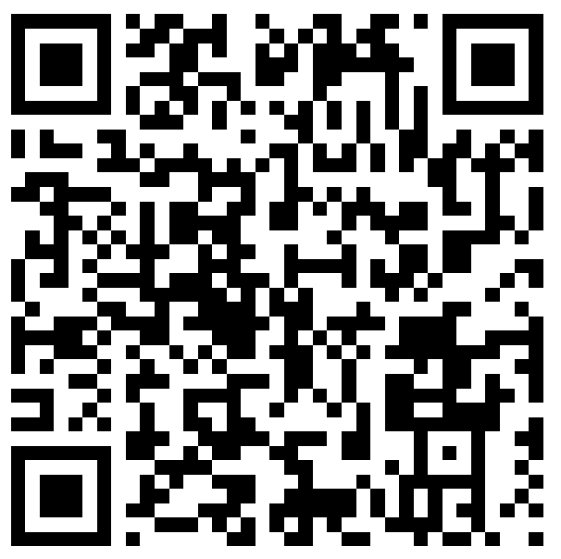
Resource Guide
Cancer in Iowa:
99 Counties Project
www.iowacancerregistry.org/99

Slide 74

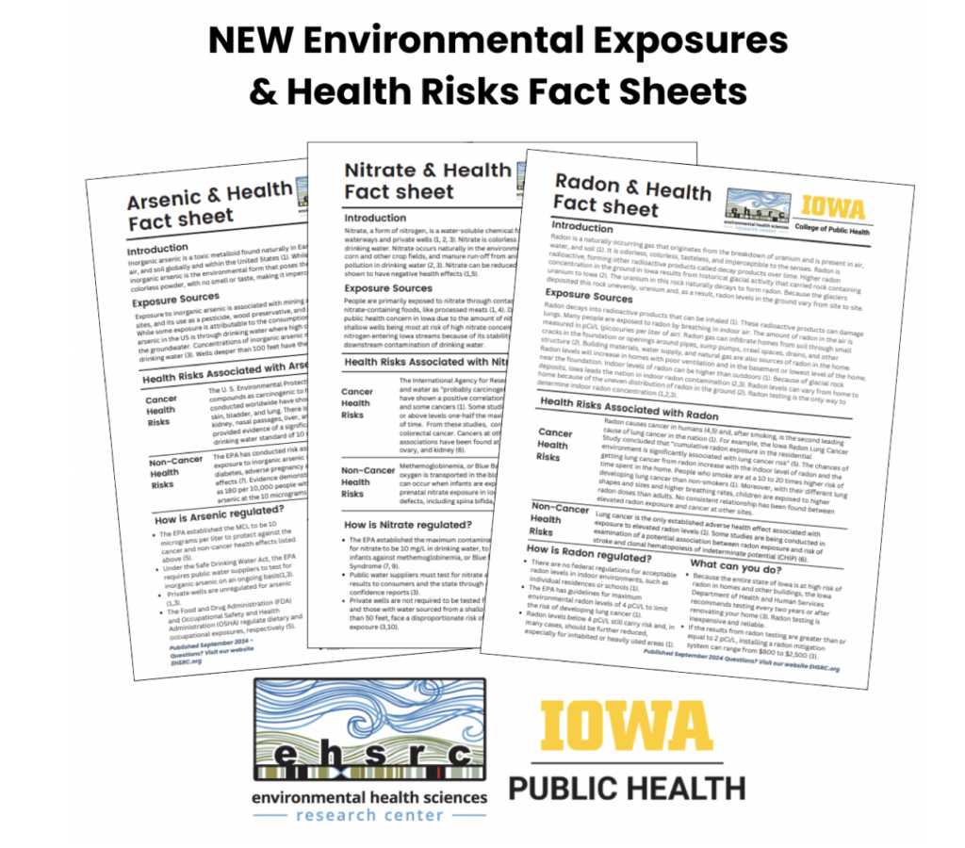

Environment-related Resources
Cancer Clusters
Iowa Private Well Grants Program, Iowa HHS
If you are concerned about cancer excess in your area, please email the Iowa Cancer Registry at ICR-CancerConcerns@uiowa.edu
Iowa's Private Well Grants Program (PWG) provides free water testing to all private well owners and users for specific analytes.
Agricultural Health Study
Center for Health Effects of Environmental Contamination (CHEEC)
The aim of this study is to understand how agricultural, lifestyle, and genetic factors affect the health of farming populations. Linked with Iowa Cancer Registry data to study risk of developing cancer among pesticide applicators. aghealth.nih.gov
CHEEC supports and conducts research to identify, measure and study adverse health outcomes related to exposure to environmental toxins.
cheec.uiowa.edu
Environmental Exposures & Health Risks Fact Sheets
Center for Energy & Environmental Education’s (CEEE), Environmental Health Program
Environmental Health Sciences Research Center created fact sheets with information on cancer and non-cancer health risks for selected environmental exposures. https://ehsrc.public-health.uiowa.edu/ communityengagement/resources-information/
Raises awareness about the link between harmful chemicals and their impacts to both people and climate.
ceee.uni.edu

Slide 75




Other initiatives in Iowa
Expert Panel
Cancer and Environmental Risk Factors in Iowa
UI Holden Cancer Center is bringing renowned national and international cancer experts together to investigate Iowa’s cancer rates.
The Harkin Institute and the Iowa Environmental Council have embarked on an initiative that explores the relationship between environmental risk factors and cancer rates in Iowa.
The initiative included a review of existing research on environmental risk factors and a statewide campaign to listen to, understand, and amplify Iowans’ own lived experiences with cancer.
Cancer Drivers in Iowa
Governor Reynolds and the legislature passed Senate File 647, which created a collaborative project with Iowa Health and Human Services and the University of Iowa College of Public Health to examine the factors behind the rise in cancer rates in Iowa.
https://iphprp.org/cancer-drivers-in-iowa/
Interim Findings Report
www.iaenvironment.org/our-work/cancer-and-environmental-risk-factors-in-iowa/

Slide 76
Main Takeaways
  Cancer is an important health issue facing your county.
  There are proven ways to prevent cancer & find it early.
  You can avoid risk factors and get screened.
  Iowa has a strong Cancer Plan, resources, & organizations to help fight cancer.
Policy changes at the local and state levels can have a huge impact!
Please communicate your concerns & needs with your state representatives and local policymakers.
This is only the first step.

Slide 77
Every community is different
Your expertise is key
Cancer control partners can help
Take stock of the information presented today
Your expertise as community members and leaders and local policy makers is key to answering the question of what to do next.
You know best what your community needs and what will work.
Cancer control partners can provide ideas, advise, and help find data, evidence, and other resources, but ultimately you are the experts.
A good place to start is by taking stock of the information presented today
Where are opportunities for change within your county, town, or organization?
Use the Iowa Cancer Plan for inspiration.
Reach out to the Iowa Cancer Consortium for partnership in moving forward.

Slide 78
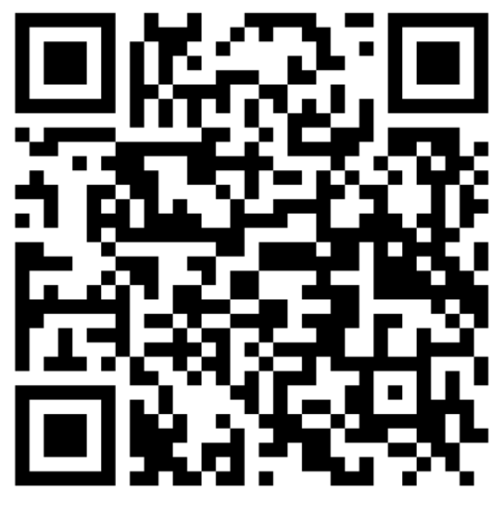
Thank you for attending!
If you would like to share your thoughts on this meeting, please participate in our brief survey. The QR code will direct you to the survey.
This brief survey should take no more than 5-10 minutes of your time.

