Slide 1
Blazing Trails in Palliative Care
Jane Schuler, MSN-FNP, ARNP
Palliative Care
Southeast Iowa Regional Medical Center

Slide 2
Learning Objectives
Describe Palliative Care philosophy and the domain of care.
Discuss our growth and journey in building our Palliative Care program.
Describe embedding Palliative Care into our Cancer Care Center.
Discuss tips and tricks we have learned on our journey.

Slide 3
Disclosure
I have no financial relationships to disclose.

Slide 4
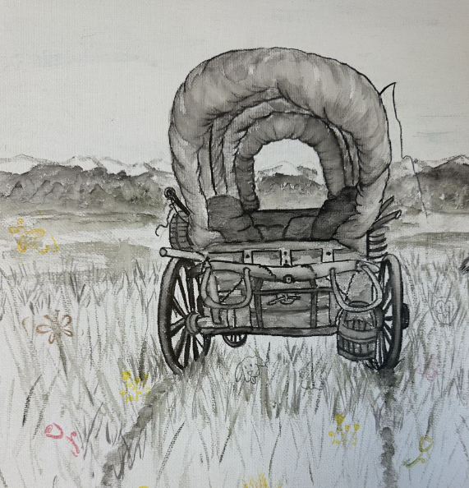
Pack your wagon for an incredible journey

Slide 5
What is Palliative Care?
Palliative Care is specialized medical care for people living with a serious illness. This type of care is focused on providing relief from the symptoms and stress of illness.
The goal is to improve quality of life for people with serious illness.
CAPC-About Palliative Care

Slide 6
Why Palliative Care?
Benefits have been well-documented nationally.
Improve quality of life.
Decrease pain and suffering.
Decrease costs.
Increase patient satisfaction.
CAPC-The Case for Hospital Palliative Care

Slide 7
Cancer Specific
Patients with advanced cancer, whether patient or outpatient, should receive dedicated Palliative Care services, early in the disease course, concurrent with active treatment.
For newly diagnosed patients with advanced cancer, the Expert Panel suggests early Palliative Care involvement within 8 weeks of diagnosis.
Patients with advanced cancer are defined as those with distant metastases, late-stage disease, cancer that is life-limiting, and/or with a prognosis of 6 to 24 months.
Ferrell ‘Integration of Palliative Care Into Standard Oncology Care:
ASCO Clinical Practice Guideline Update’, Journal of Clinical Oncology, 2016

Slide 8

Domains of Palliative Care (Clinical Practice Guidelines)
Structure and Process.
Physical.
Psychological.
Social.
Spiritual.
Cultural.
Care of Imminently Dying.
Ethical.
National Consensus Panel-Clinical Practice Guidelines for Quality Palliative Care

Slide 9
Palliative Care Can Help With…
Goals of care/shared decision-making.
Advanced care planning/resuscitation status.
Symptom management.
Emotional and spiritual distress.
Collaboration with primary physicians and across settings.
Help patients and families navigate the complex healthcare system.

Slide 10

Navigating Patient's Health Care Journey The SEIRMC Palliative Care GPS
G – Goals of Care​.
​
P – Psychosocial/Spiritual Support.​
​
S – Symptom Management​.

Slide 11
Goals of Care
Palliative Care ensures that patient/family goals match the medical care received.
Family meetings.
Discuss disease trajectory and prognosis.
Educate on the benefits and burdens of medical interventions.
Advanced Directives.
IPOST.

Slide 12
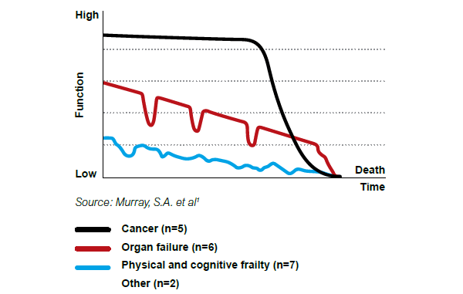
Trajectory of Illness

Slide 13
Psychosocial Support
Palliative Care addresses the emotional, spiritual, and social concerns associated with a serious illness.
Psychosocial evaluation.
Connect to local resources.
Explore Medicare/Medicaid benefits available.
Explore the role of faith beliefs and how it affects coping.
Emotional support throughout the course of treatment.

Slide 14
Symptom Management
Palliative Care helps with:
Cancer-related pain relief.
Shortness of breath.
Situational anxiety.
Situational depression.
Nausea.
Constipation.

Slide 15
Growth and Journey
2012
Staffing
2017
Service Provided
2018
Service Provided
WB Inpatient
Provider 0.2 FTE
RN 1.0 FTE
SW 0.3 FTE
WB Inpatient
LTC Klein
Staffing
Provider 1.0 FTE
RN 1.0 FTE
SW 1.0 FTE
2019
Service Provided
WB Inpatient
LTC Klein
Staffing
Provider 2.0 FTE
WB Outpatient
RN 2.0 FTE
SW 1.0 FTE
Service Provided
WB Inpatient
LTC Klein
Cancer Care
WB Outpatient
Provider 2.0 FTE
Staffing
RN 2.0 FTE
SW 1.0 FTE
2022
Service Provided
Cancer Care
WB Inpatient
LTC Klein
WB Outpatient- Clinic
Staffing
Provider 2.0 FTE
RN 2.0 FTE
SW 1.0 FTE
2023
FM Inpatient
Service Provided
WB Inpatient
LTC Klein
WB Outpatient- Clinic
Cancer Care
Caregiver Support Group
SW 2.0 FTE
Staffing
Provider 2.0 FTE
RN 3.0 FTE
2024
Service Provided
WB Inpatient
LTC Klein
WB Outpatient- Clinic
Cancer Care
FM Inpatient
Caregiver Support Group
Coalition on Cancer
Staffing
Provider 2.0 FTE
RN 3.0 FTE
SW 2.0 FTE
Tumor Board
Survivorship Class
FM Outpatient
Patient Partners
Registration Clerk 1.0 FTE
Registration Clerk 1.0 FTE
Registration Clerk 1.0 FTE

Slide 16
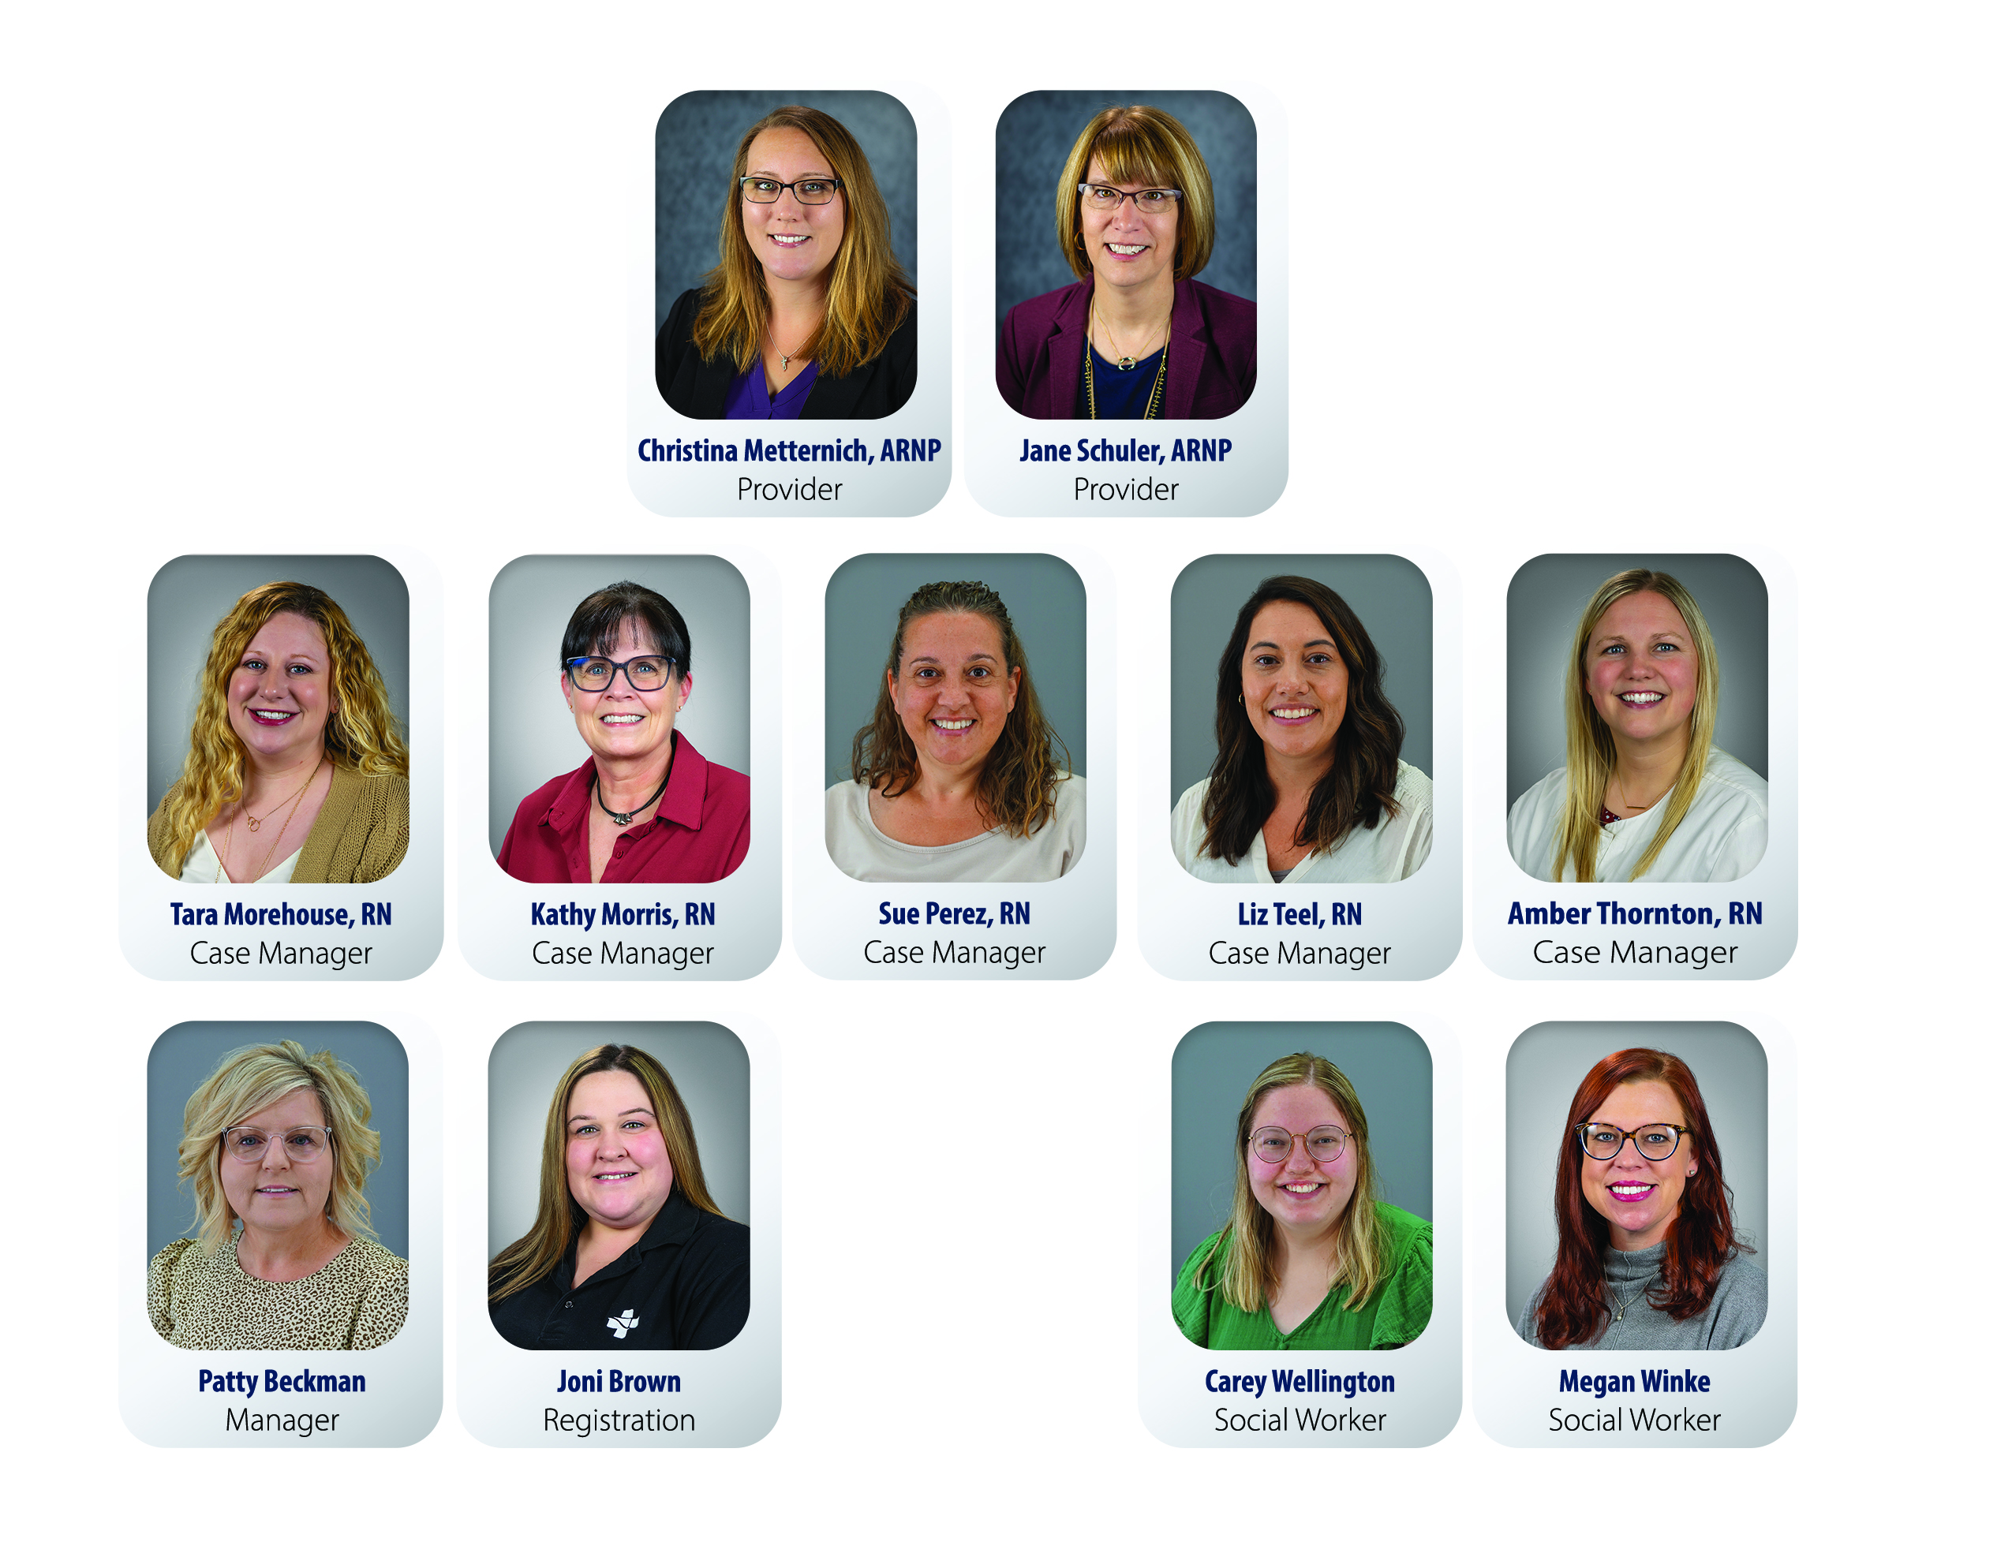
Our Current Team

Slide 17
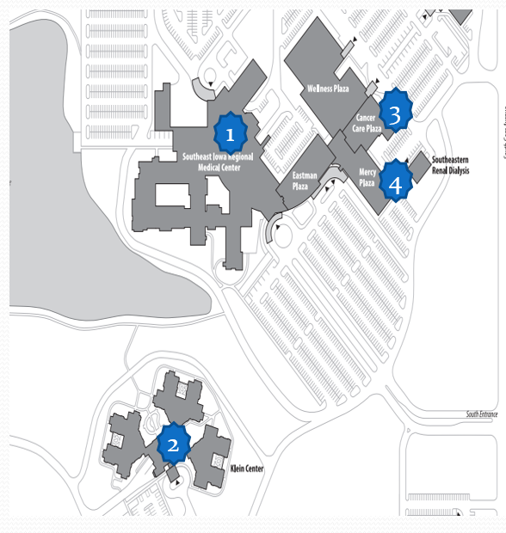
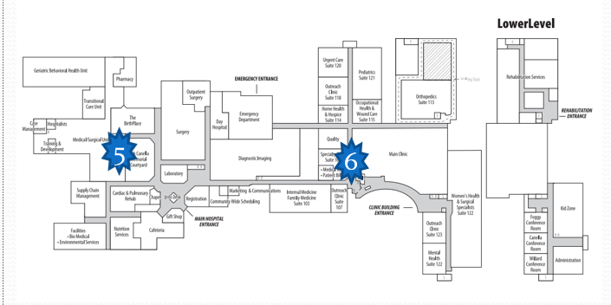
Palliative Care Locations
West Burlington Campus
Fort Madison Campus
1- Inpatient- West Burlington
2- Long Term Care- Klein Center
3- Cancer Care Center
4- Palliative Care Clinic
5- Inpatient- Fort Madison
6- Outpatient Clinic- Fort Madison

Slide 18

Crossing into New Territory

Slide 19
Destination: Palliative Care Program Guide to Program Development
G – Gather information.
Gain insight.
P – Patient-focused.
Process improvement.
​
S – Suffering reduction.
Survive.

Slide 20
Gather Information, Gain Insight
Needs assessment.
Administration approval - capture the C-Suite.
Provider buy-in.
Professional memberships/education.
AAHMP/HPNA.
Elnec Training.
AAHPM Forums.
Respecting Choices - IPOST.
CAPC.
Palliative Care Certification - RN and Social Worker.
Networking.
Journal Club.
Site Visits.

Slide 21
Process Improvement, Patient Focused
Process Improvement.
Always look for tools to add to your toolbox.
Don't let the wheels fall off your wagon.
Patient Focused.
Capture the patient before the crisis.
Meet the patient and family where they are.

Slide 22
Suffering Reduction, Survive
Suffering Reduction.
Assess for suffering in domains of Palliative Care.
Aggressive treatment of areas of suffering.
Survive.
Be ready for a bumpy road.
Avoid snakebites.

Slide 23
Embedding in Cancer Care Remember the GPS
Needs assessment.
Administration approval - capture the C-Suite.
Provider buy-in.
Education.
Basic Oncology education.
Chemotherapy teaching.
Networking.
Oncologists.
Radiation Oncologist.
Oncology RNs, CMAs.
Scheduler/receptionists.

Slide 24
Embedding in Cancer Care Remember the GPS
Process improvement.
Education to Oncology team.
Develop referral cards.
Scheduling patient around Cancer Care appointments.
Early referrals.
Patient Focused.
Shared decision-making.
Pacing.

Slide 25
Embedding in Cancer Care Remember the GPS
Suffering reduction.
Assess for suffering in domains of Palliative Care.
Aggressive treatment of areas of suffering.
Survive.
Be ready for a bumpy road.
Avoid snakebites.

Slide 26
Careful Considerations: Symptom Management
Kidney and liver function.
Insurance constraints - prior authorizations and limits.
Drug interactions.
Cardiac issues- EKG prior to Methadone.
Coordination of other providers.
Support in the home.
Safety - Opioid Risk Tool, Narcan, Opioid contract.

Slide 27
Tips and Tricks
Schedule patient around Cancer Center appointments.
Anticipate patients who may need weekly appointments.
Clinical Practice Guidelines.
Surrogate Decision Maker.
Assess the patient's Goals of Care.
Communication with Oncology team.

Slide 28

Happy Trails

Slide 29
Questions?

Slide 30
References
Center to Advance Palliative Care, The Case for Hospital Palliative Care
National Consensus Project, Clinical Practice Guidelines for Quality Palliative Care
Ferrell ‘Integration of Palliative Care Into Standard Oncology Care:
ASCO Clinical Practice Guideline Update’, Journal of Clinical Oncology, 2016

